Slide 1
Personal protective suits and equipment
Made by: Ronaldo Goreta
Place: Šibenik
Name of the institution: My home
Date and time of making: 20th of May 2020. at 6 P.M.

Slide 2
Personal protective equipment (PPE)
PPE is protective clothing, helmets, goggles, or other garments or equipment designed to protect the wearer's body from injury or infection
The hazards addressed by protective equipment include physical, electrical, heat, chemicals and biohazards matter
The purpose of personal protective equipment is to reduce employee exposure to hazards

Slide 3
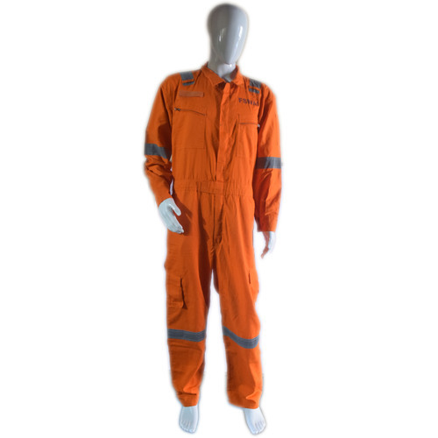
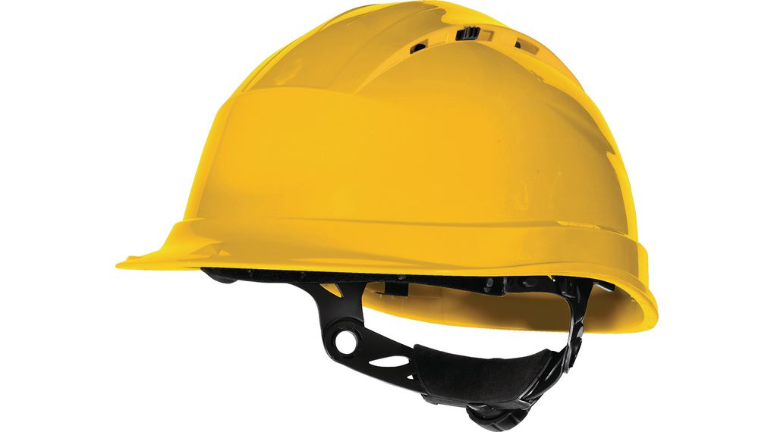
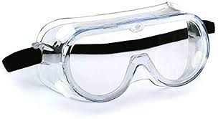
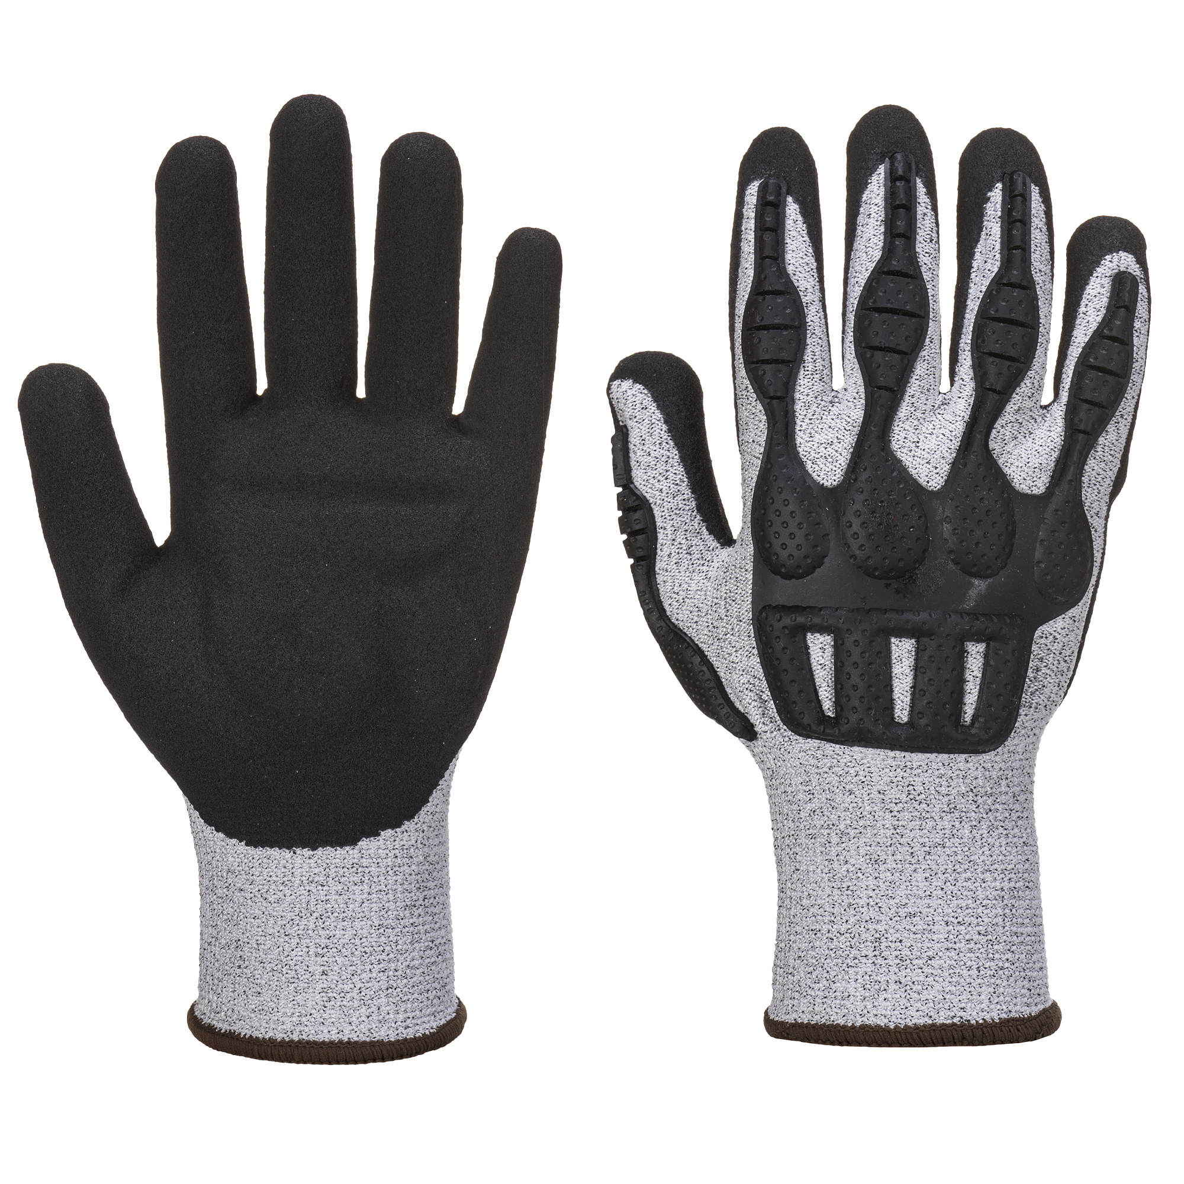
Personal protective equipment:
Protective suit
Protective helmet
Protective googles
Protective gloves
Click here to watch a video of what protective equipment you need on ship

Slide 4
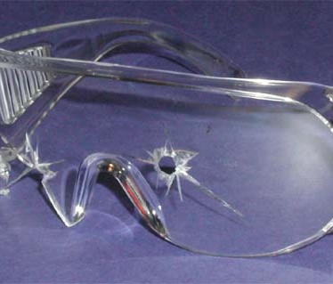
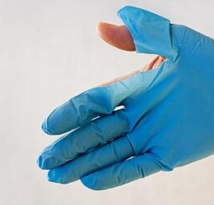
PPE has the serious limitation that it does not eliminate the hazard at the source and may result in employees being exposed to the hazard if the equipment fails.
Any item of PPE imposes a barrier between the wearer/user and the working environment.
Good ergonomic design can help to minimize injuries and can therefore help to ensure safe and healthy working conditions through the correct use of PPE.

Slide 5
Skin protection
Occupational skin diseases such as skin cancer and other skin diseases and infections are one of the most common type of occupational diseases and can be very dangerous.
Any form of PPE that acts as a barrier between the skin and the agent of exposure can be considered skin protection.
Because much work is done with the hands,gloves are most important item in providing skin protection.

Slide 6
Eye protection
Eye injuries can happen through a variety of means.
Most eye injuries occur when solid particles such as metal slivers, wood chips, sand or cement chips get into the eye.
Blunt force trauma can occur to the eye when excessive force comes into contact with the eye.

Slide 7
Hearing protection
Industrial noise is often overlooked as occupational hazard, because it is not visible to the eye.
PPE for hearing protection consists of earplugs and earmuffs
Workers who are regularly exposed to noise levels above the average level have higher risk of losing hearing at young age.

Slide 8
Hazards
Most known occupational hazards are: physical, chemical and biological.
Physical hazard: A physical hazard is an agent, factor or circumstance that can cause harm without contact.
Chemical hazard: It is a type of occupational hazard caused by exposure to chemicals in the workplace
Biological hazard: It is a substance that poses a threat to the health of humans

Slide 9
Important things to remember!
Always check your equipment properly before you put it on
Put your protective equipment slowly and properly to avoid accidents
Don’t forget or underestimate hearing equipment!
After you are done with the work clean your equipment before putting it on for next time

Slide 10
THE END
Thank you for your attention, stay clever and be careful.

