Slide 1
AMERICAN FOOTBALL
National Football League

Slide 3
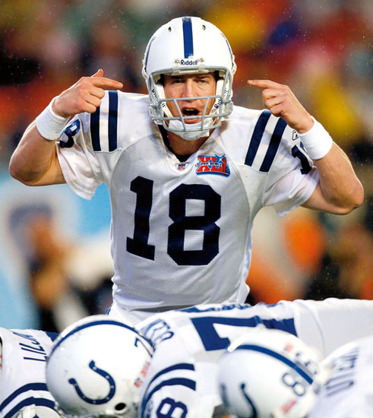
American football (known as football in the United States and gridiron in some other countries) is a sport played by two teams of eleven players on a rectangular field 120 yards long by 53.33 yards wide with goalposts at each end.

Slide 4
The offense attempts to advance an oval ball down the field by running with or passing it. They must advance it at least ten yards in four downs to receive a new set of four downs and continue the drive, if not, they turn over the football to the opposing team
Most points are scored by advancing the ball into the opposing team's end zone for a touchdown or kicking the ball through the opponent's goalposts for a field goal. The team with the most points at the end of a game wins

Slide 5
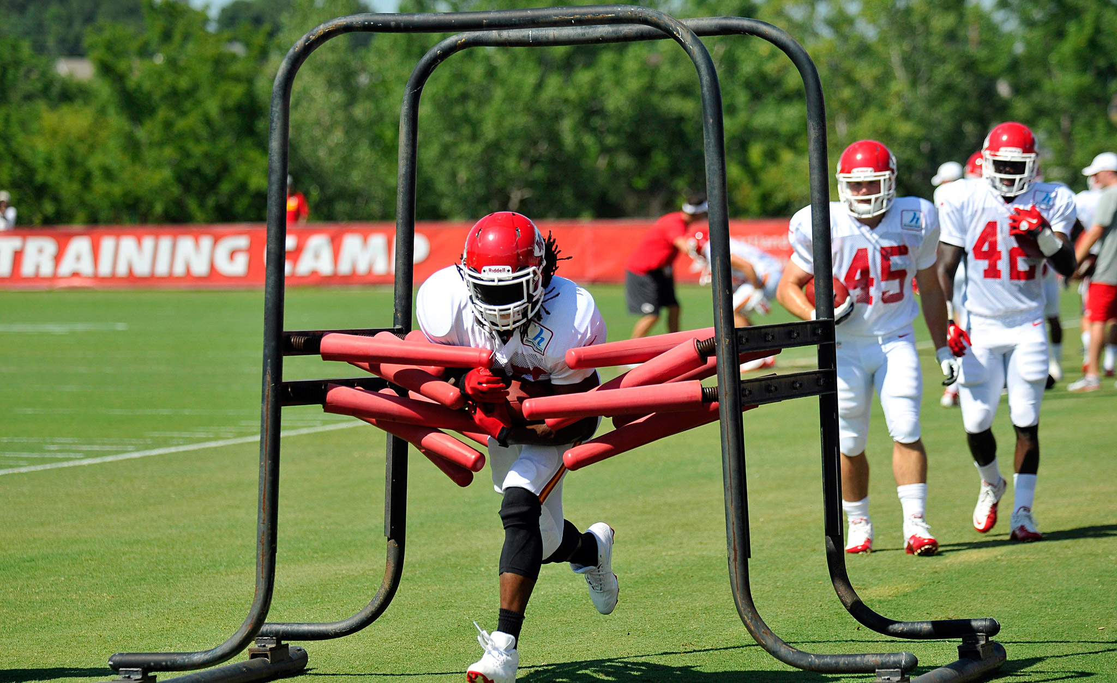

Slide 6
LAYING (touchdown)
Laying is the main way which brings the highest number of points. Its value is 6 points.
Laying can be achieved in several ways: by entering the ball into the opponent's end zone, trapping added to the opponent's end zone or capturing anyone's ball (fumble) in the opponent's end zone.
Achieved routing allows offensive team and an additional attempt to win extra points whose value is 1 point or if they need a team may decide to try to win an additional two points.

Slide 8
The National Football League

Slide 9
The National Football League (NFL) is a professional American football league that constitutes one of the four major professional sports leagues in North America. It is composed of 32 teams divided equally between the National Football Conference and the American Football Conference.

Slide 10
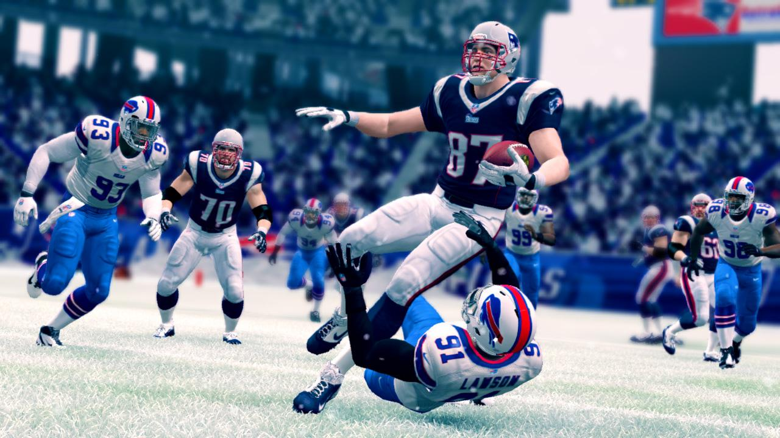

Slide 11
The highest professional level of the sport in the world, the NFL runs a 17-week regular season from the week after Labor Day to the week after Christmas, with each team playing sixteen games and having one bye week each season.
Out of the league 32 teams, six from each conference compete in the NFL playoffs, a single-elimination tournament culminating in the Super Bowl, played between the champions of the NFC and AFC.
The champions of the Super Bowl are awarded the Vince Lombardi Trophy.

Slide 13
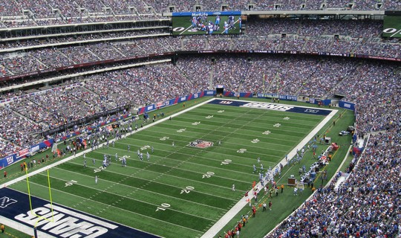
NFL STADIUMS

Slide 14
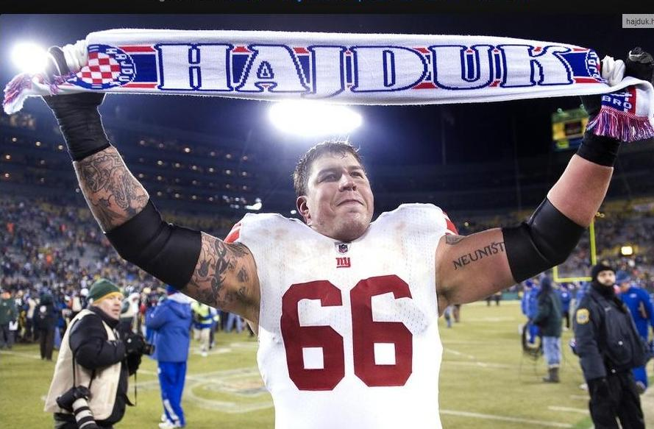
Best Croatian NFL Player
DAVID DIEHL

Slide 16
Izradio: Krešimir Čondrić, 3.a

