Slide 1
Anchoring
Mauro Polić 2.c

Slide 2
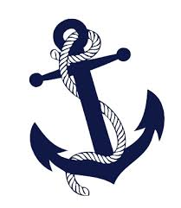
An anchor is a device, normally made of metal, used to connect a vessel to the bed of a body of water to prevent the craft from drifting due to wind or waves.

Slide 3
Anchors can either be temporary or permanent. Permanent anchors are used in the creation of a mooring, and are rarely moved; a specialist service is normally needed to move or maintain them. Vessels carry one or more temporary anchors, which may be of different designs and weights.

Slide 4
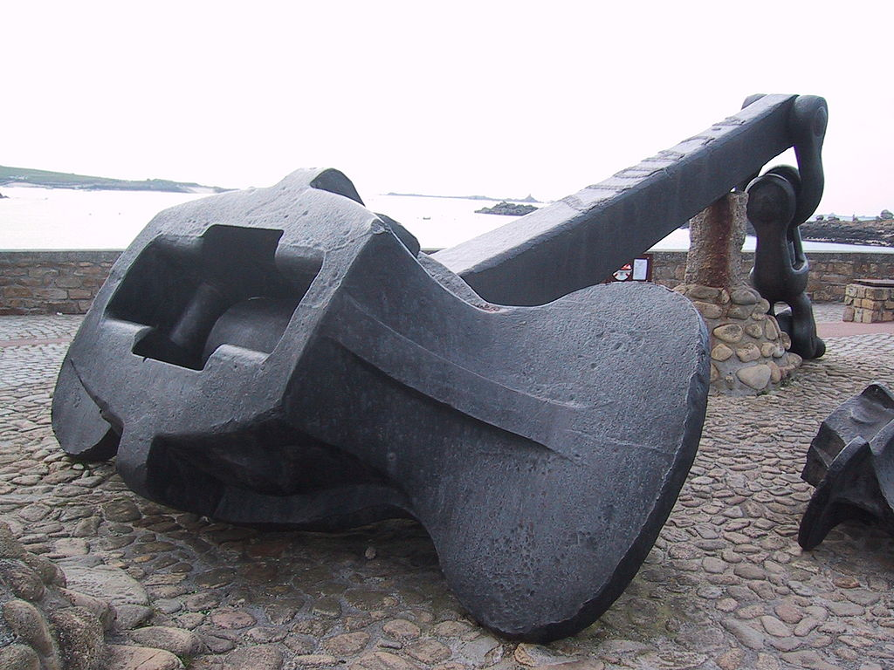
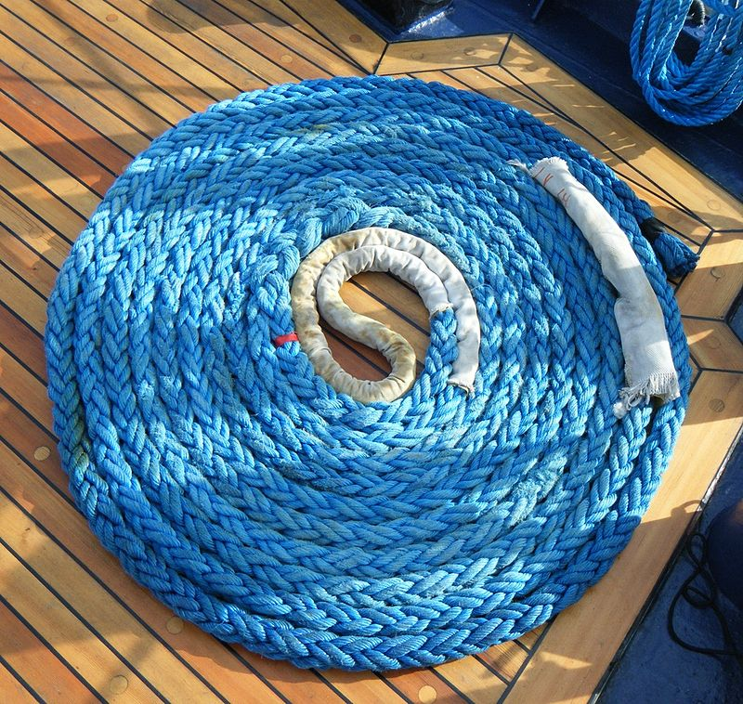

Slide 5
The History of the anchor dates back millennia. The most ancient anchors were probably rocks and many rock anchors have been found dating from at least the Bronze Age.

Slide 6
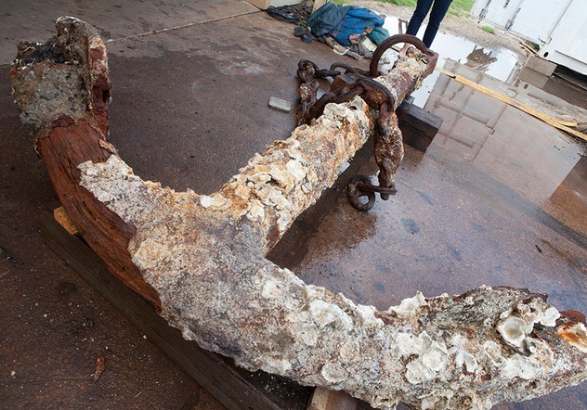

Slide 7
An anchor windlass is a machine that restrains and manipulates the anchor chain on a boat, allowing the anchor to be raised and lowered by means of chain cable. A notched wheel engages the links of the chain or the rope.

Slide 8
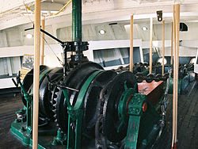
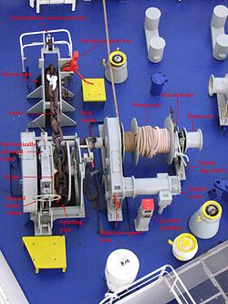

Slide 9
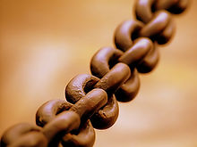
A chain is a serial assembly of connected pieces, called links, typically made of metal, with an overall character similar to that of a rope in that it is flexible and curved in compression but linear, rigid, and load-bearing in tension. A chain may consist of two or more links.

Slide 10
BYE!

