Slide 1
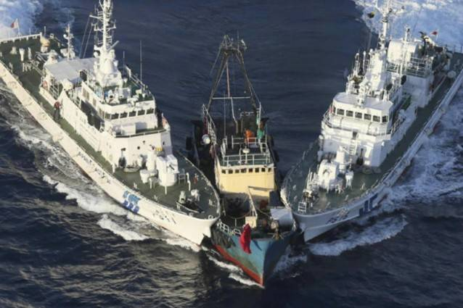
COLLISION REGULATION

Slide 2
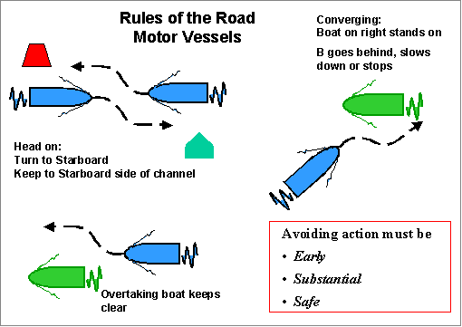

Slide 3
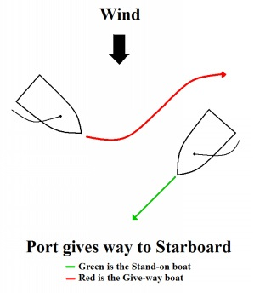
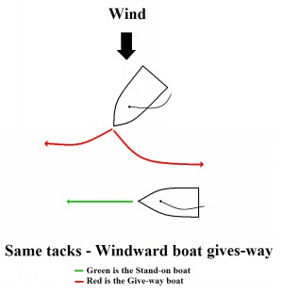

Slide 4
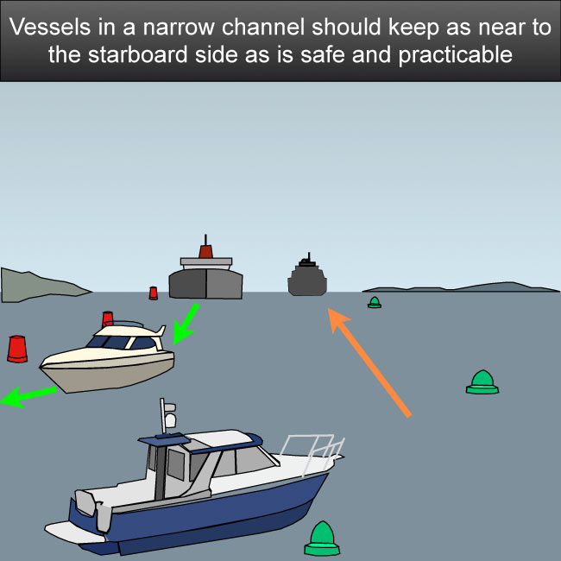
PREFACE
The International Regulations for Preventing Collisions at Sea 1972(Colregs) are published by the International Maritime Organization (IMO)

Slide 5
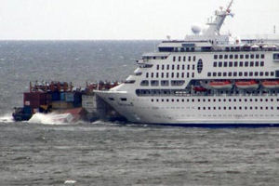
The COLREGs are derived from a multilateral treaty called the “Convention on the International Regulations for Preventing Collisions at Sea.”

Slide 6
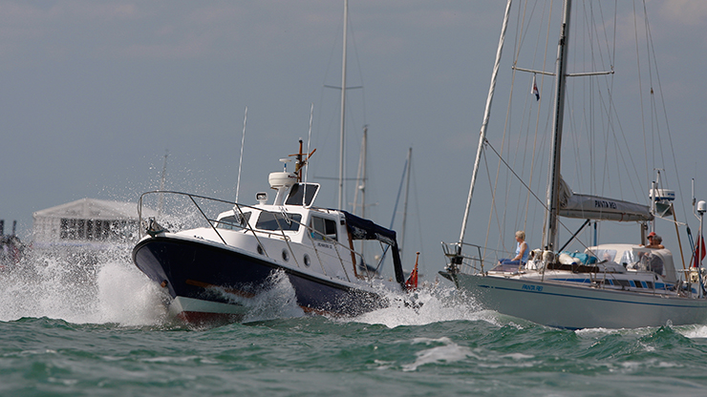
HISTORY
Prior to the development of a single set of international rules and practices, there existed separate practices and various conventions and informal procedures in different parts of the world, as advanced by various maritime nations.

Slide 7
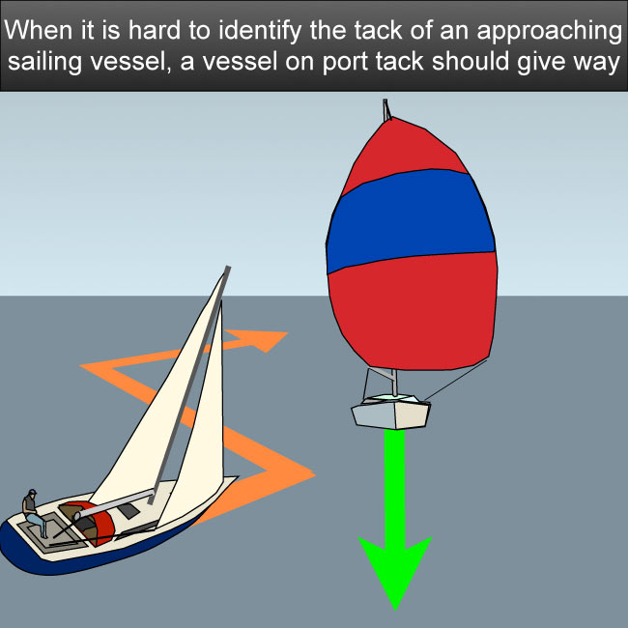
As a result, there were inconsistencies and even contradictions that gave rise to unintended collisions.

Slide 8
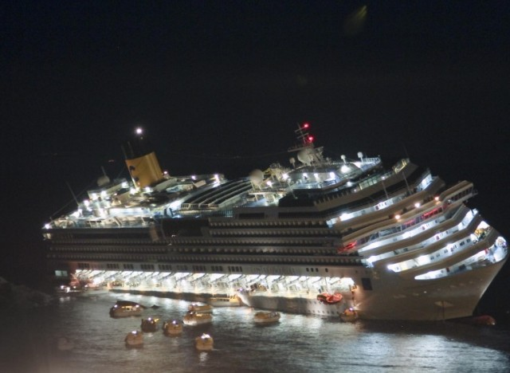
Vessels’ navigation lights for operating in darkness as well as navigation marks also were not standardized, giving rise to dangerous confusion and ambiguity between vessels at risk of colliding.

Slide 9
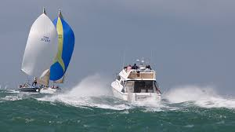
The International Regulations for Preventing Collisions at Sea were adopted as a convention of the International Maritime Organization on 20 October 1972 and entered into force on 15 July 1977.

Slide 10
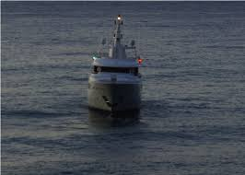
They were designed to update and replace the Collision Regulations of 1960, particularly with regard to Traffic Separation Schemes (TSS) following the first of these, introduced in the Strait of Dover in 1967.

Slide 11
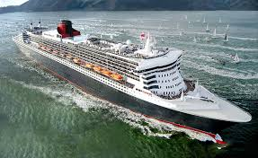
As of June 2013, the convention has been ratified by 155 states representing 98.7% of the tonnage of the world's merchant fleets. They have been amended several times since their first adoption.

Slide 12
Franko Čolak, 2.C

