Slide 1
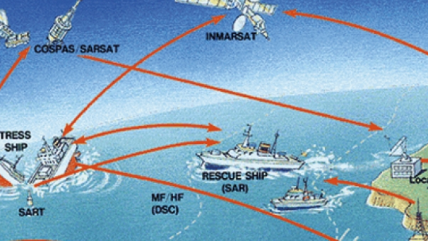
GMDSS
Gabrijel Alviž 2.c

Slide 2
GMDSS
The Global Maritime Distress and Safety System (GMDSS) is an internationally agreed-upon set of safety procedures, types of equipment, and communication protocols used to increase safety and make it easier to rescue distressed ships, boats and aircraft.
GMDSS consists of several systems, some of which are new, but many of which have been in operation for many years. The system is intended to perform the following functions: alerting (including position determination of the unit in distress), search and rescue coordination, locating (homing), maritime safety information broadcasts, general communications, and bridge-to-bridge communications.
Specific radio carriage requirements depend upon the ship's area of operation, rather than its tonnage. The system also provides redundant means of distress alerting, and emergency sources of power.

Slide 3
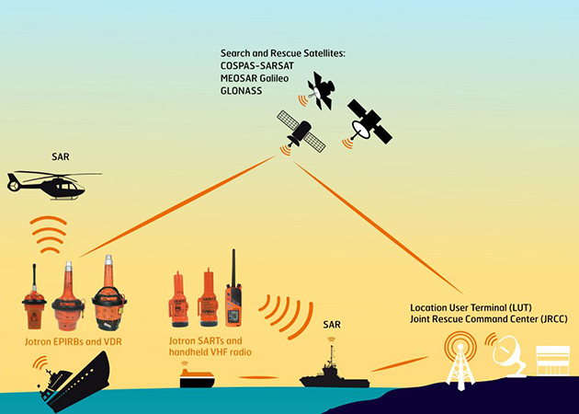
Picture of communication lines in GMDSS system

Slide 4
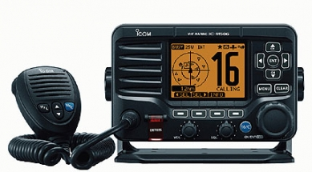
Recreational vessels do not need to comply with GMDSS radio carriage requirements, but will increasingly use the Digital Selective Calling (DSC) Marine VHF radios.
Offshore vessels may elect to equip themselves further. Vessels under 300 gross tonnage (GT) are not subject to GMDSS requirements.

Slide 5
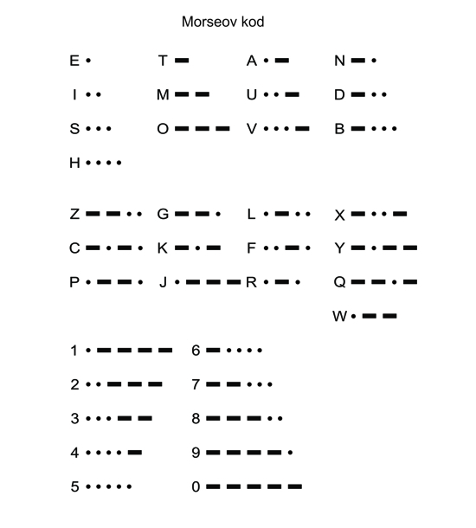
Since the invention of radio at the end of the 19th century, ships at sea have relied on Morse code, invented by Samuel Morse and first used in 1844, for distress and safety telecommunications.
The need for ship and coast radio stations to have and use radiotelegraph equipment, and to listen to a common radio frequency for Morse encoded distress calls, was recognized after the sinking of the liner RMS Titanic in the North Atlantic in 1912.
The U.S. Congress enacted legislation soon after, requiring U.S. ships to use Morse code radiotelegraph equipment for distress calls. The International Telecommunications Union (ITU), now a United Nations agency, followed suit for ships of all nations.
Morse encoded distress calling has saved thousands of lives since its inception almost a century ago, but its use requires skilled radio operators spending many hours listening to the radio distress frequency. Its range on the medium frequency (MF) distress band (500 kHz) is limited, and the amount of traffic Morse signals can carry is also limited.

Slide 6
Emergency position-indicating radio beacon (EPIRB)
Cospas-Sarsat is an international satellite-based search and rescue system, established by Canada, France, the United States, and Russia. These four countries jointly helped develop the 406 MHz Emergency Position-Indicating Radio Beacon (EPIRB), an element of the GMDSS designed to operate with Cospas-Sarsat system. These automatic-activating EPIRBs, now required on SOLAS ships, commercial fishing vessels, and all passenger ships, are designed to transmit to alert rescue coordination centers via the satellite system from anywhere in the world.
The original COSPAS/SARSAT system used polar orbiting satellites, but in recent years the system has been expanded to also include 4 geostationary satellites. Newest designs incorporate GPS receivers to transmit highly accurate positions (within about 20 metres) of the distress position. The original COSPAS/SARSAT satellites could calculate EPIRB position to within about 3 nautical miles (5.6 km) by using Doppler techniques.
By the end of 2010, EPIRB manufacturers may be offering AIS (automatic identification system) enabled beacons. The serviceability of these items is checked monthly and annually, and they have limited battery shelf life, between two and five years using mostly lithium-type batteries. 406 MHz EPIRBs transmit a registration number which is linked to a database of information about the vessel.

Slide 7
NAVTEX
Navtex is an international, automated system for instantly distributing maritime safety information (MSI) which includes navigational warnings, weather forecasts and weather warnings, search and rescue notices and similar information to ships. A small, low-cost and self-contained "smart" printing radio receiver is installed on the bridge, or the place from where the ship is navigated, and checks each incoming message to see if it has been received during an earlier transmission, or if it is of a category of no interest to the ship's master.
The frequency of transmission of these messages is 518 kHz in English, while 490 kHz is sometime used to broadcast in a local language. The messages are coded with a header code identified by the using single letters of the alphabet to represent broadcasting stations, type of messages, and followed by two figures indicating the serial number of the message. For example: FA56 where F is the ID of the transmitting station, A indicates the message category navigational warning, and 56 is the consecutive message number.

Slide 8
Satellite
After January 2020, there are two certified providers of GMDSS satellite services: INMARSAT, with several of their commsats in equatorial geosynchronous orbit, and Iridium Communications, with their 66-satellite constellation in low-Earth orbit (LEO) that can cover higher latitudes and operate with lower communications latency.
The certification of Iridium in 2020 ended a monopoly on the provision of the satellite-based portion of maritime distress services that had previously been held by Inmarsat since the system became operational in 1999.Thuraya has indicated that it may be interested in becoming a GMDSS service provider in the future.

Slide 9
Requirements
Power supply requirements
GMDSS equipment is required to be powered from three sources of supply:
ship's normal alternators/generators;
ship's emergency alternator/generator (if fitted); and
a dedicated radio battery supply.

