Slide 1
Fire fighting
Made: Nikolina Čančar
Mentor:

Slide 2
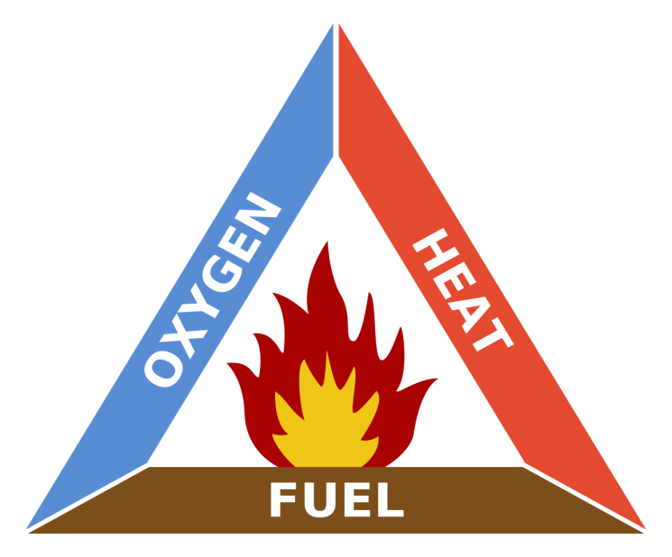
A fire on a ship is one of the most dangerous accidents which can happen on board.
If the fire is detected in good time, the crew can prevent larger damages by taking immediate measures.
If the fire has already spread, professional aid is absolutely needed, which can be rendered via helicopter or by ship.

Slide 3
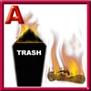
Classes of fire
Class A:Ordinary combustibles or fibrous material, such as wood, paper, cloth, rubber, and some plastics.
Class B:Flammable or combustible liquids such as gasoline, kerosene, paint, paint thinners and propane.

Slide 4
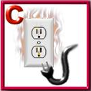
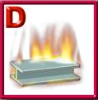
Class C: Energized electrical equipment, such as appliances, switches, panel boxes and power tools.
Class D: Certain combustible metals, such as magnesium, titanium, potassium, and sodium.
Class K: Cooking oils, trans-fats, or fats

Slide 5
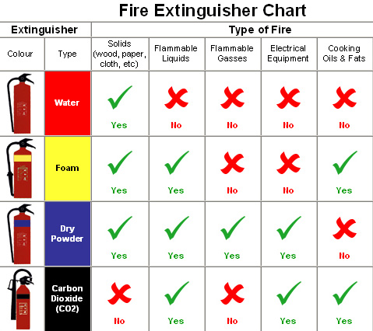

Slide 6
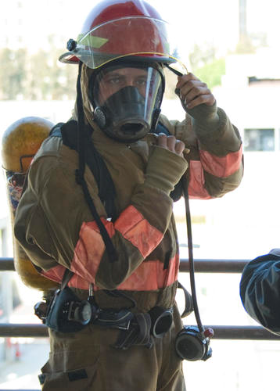
Fire Fighting Equipment

Slide 7
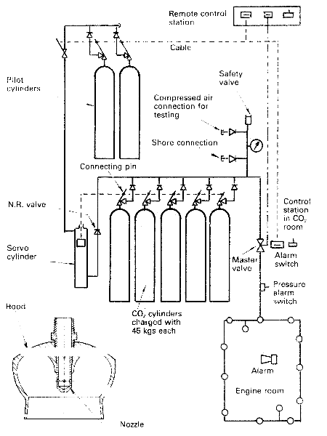
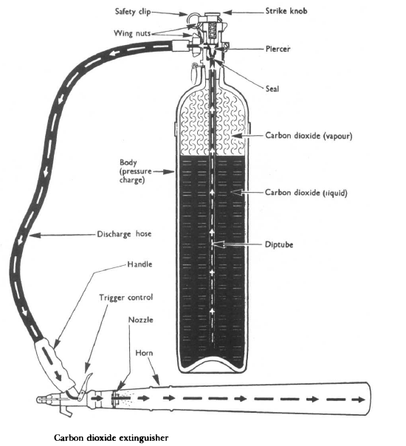
For fire fighting drills and equipment is rensposible The First Officer

Slide 8
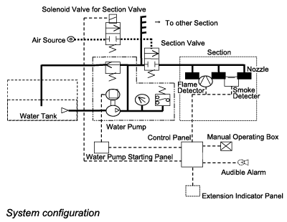
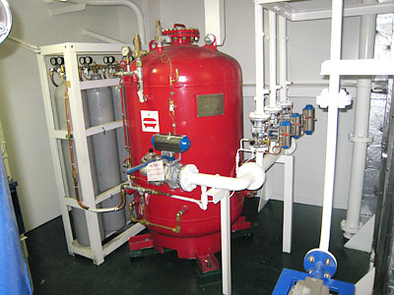

Slide 9
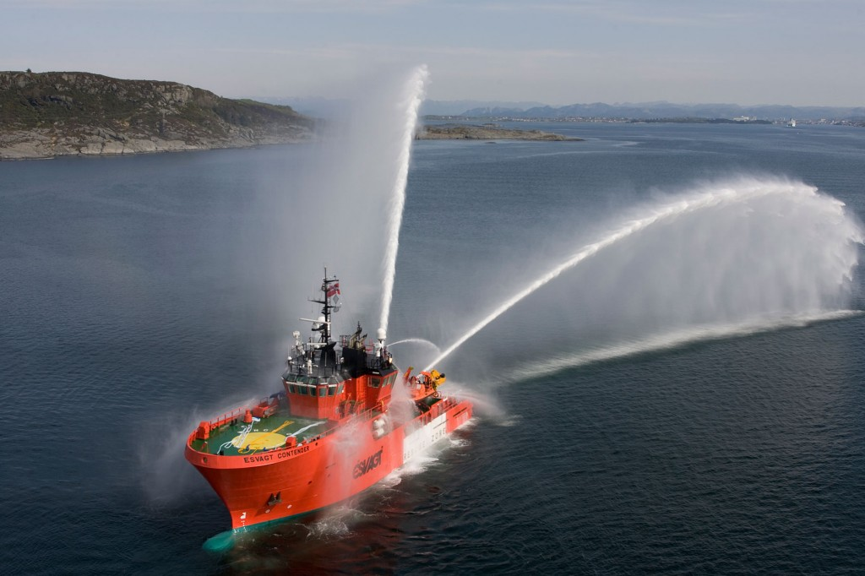

Slide 10
THE END

