Slide 1
Firefighting onboard
Višen Ševo 2.c

Slide 2
A combination of three elements (air, fuel and heat) causes fire to take place.

Slide 3
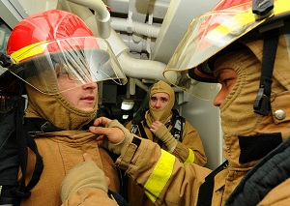
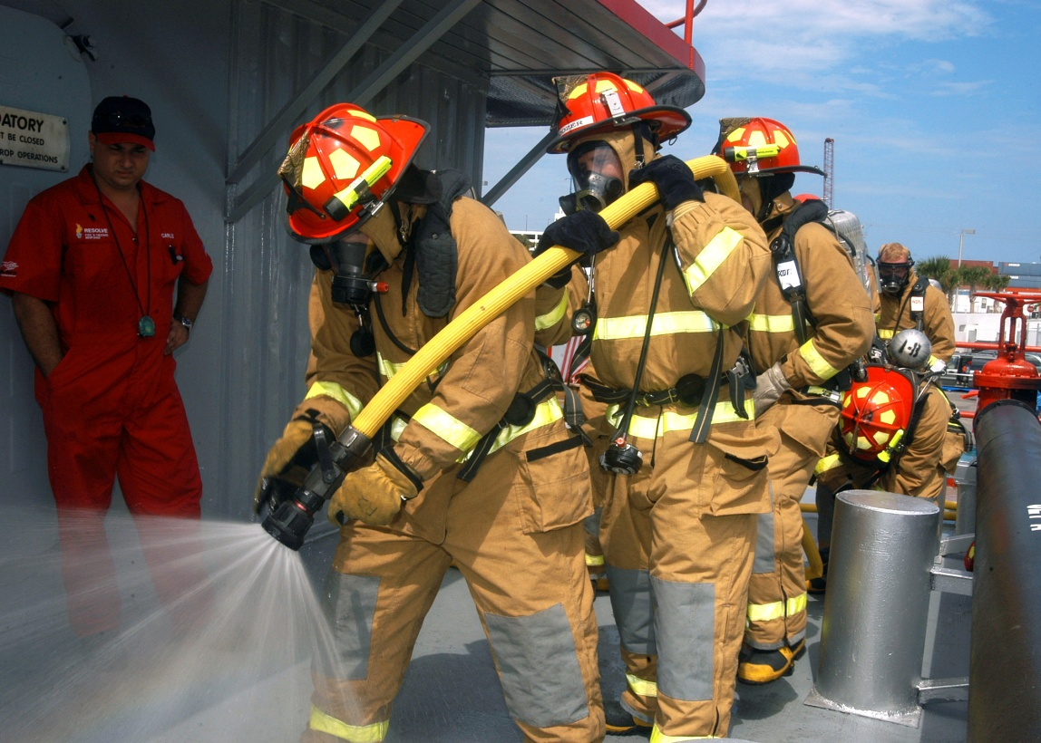
DRILLS
The purpose of carrying out any kind of drill on the ships is to make the crew acquainted with various procedures to be followed during emergency situations.

Slide 4
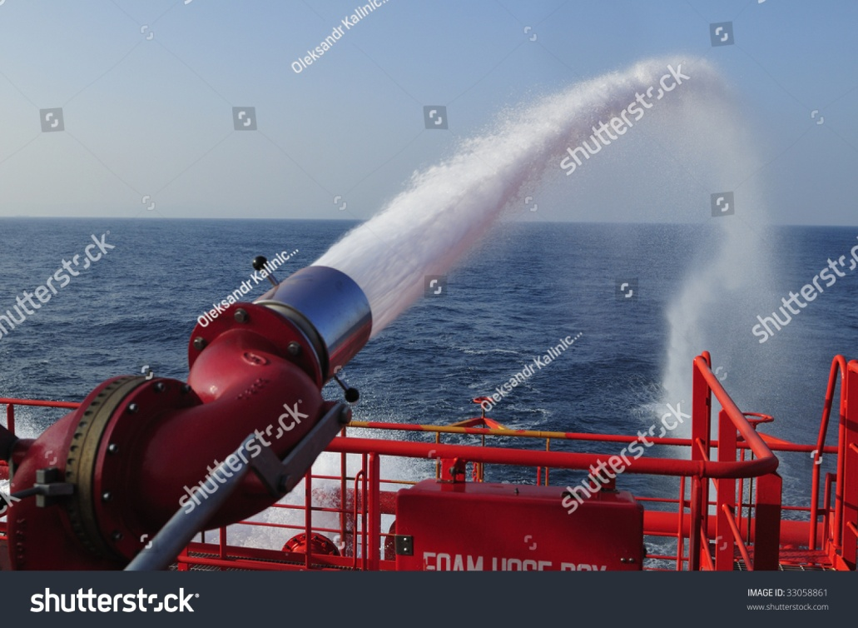
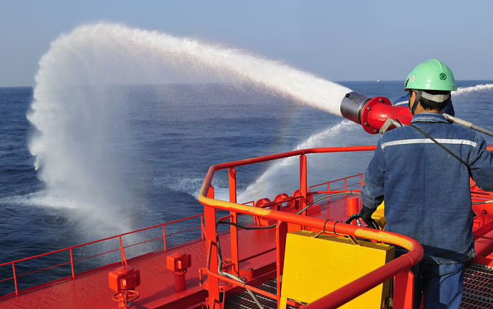
Fire Fighting Foamwater Gun
A deluge gun, fire monitor, master stream or deck gun is an aimable controllable high-capacity water jet used for manual firefighting or automatic fire protection systems.

Slide 5
Fire fighting equipment

Slide 6
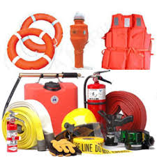
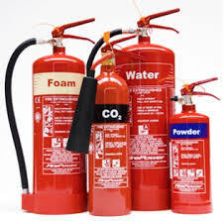
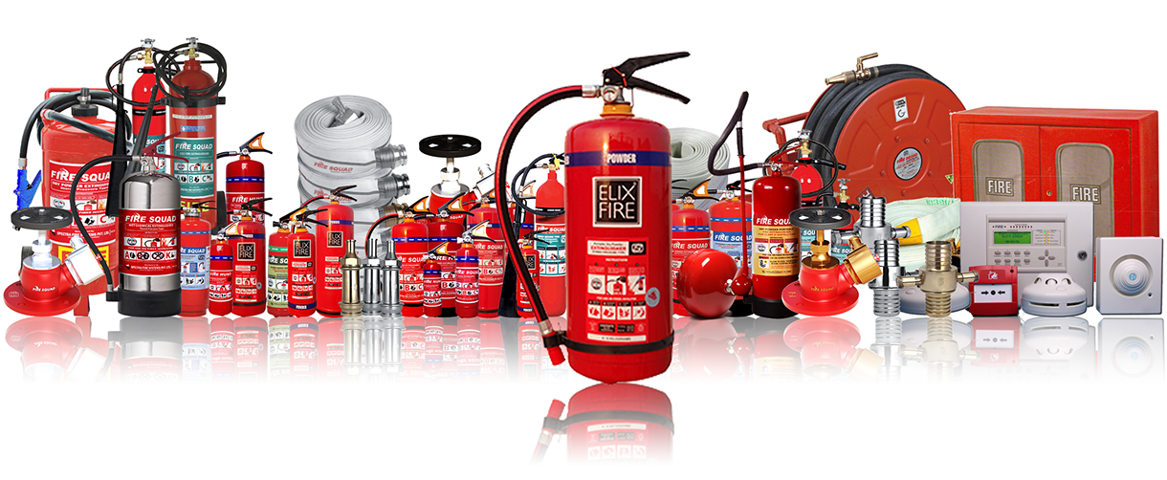

Slide 7
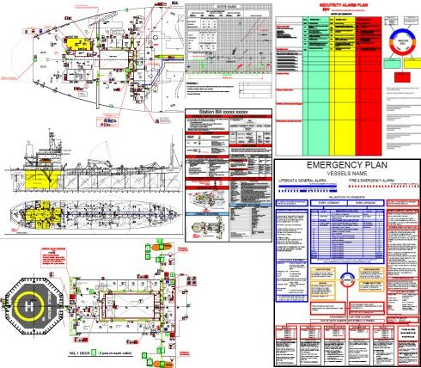
Fire fighting organization on board

Slide 8
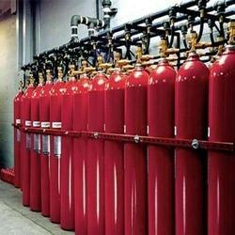
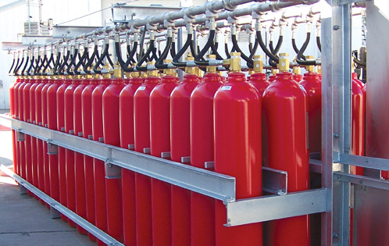
Gas Suppression System
Automatic fire suppression systems control and extinguish fires without human intervention.

Slide 9
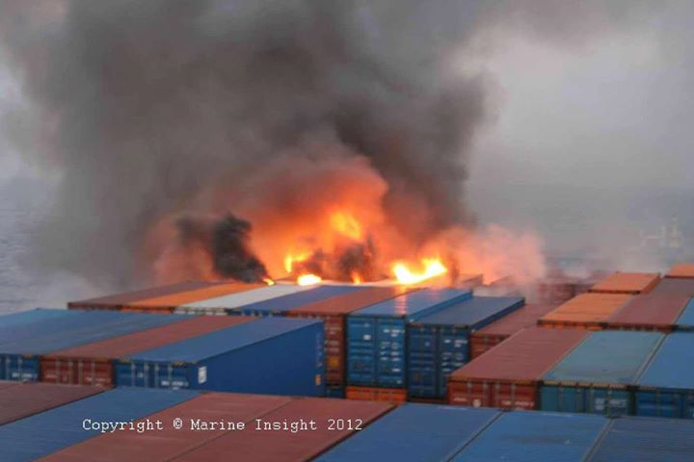
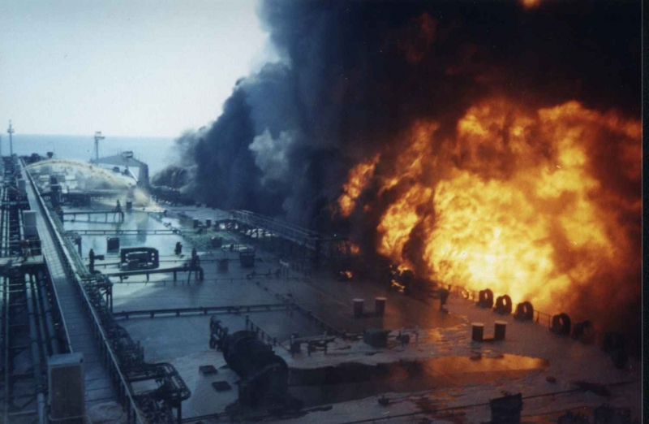
Fire onboard

Slide 10
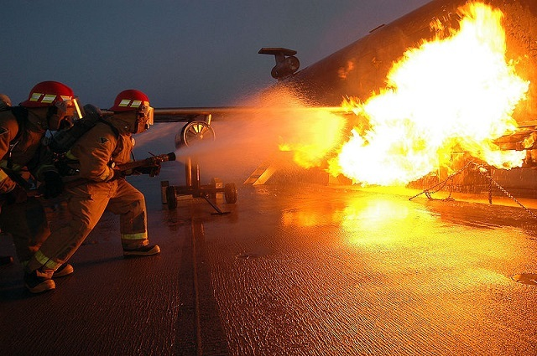
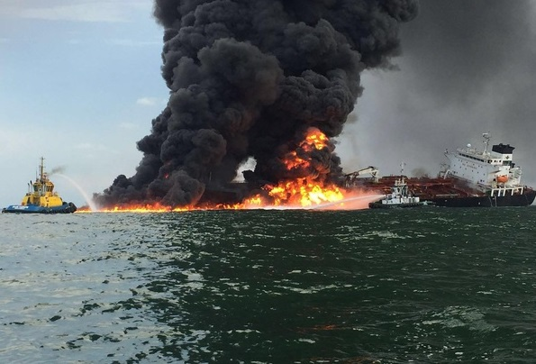
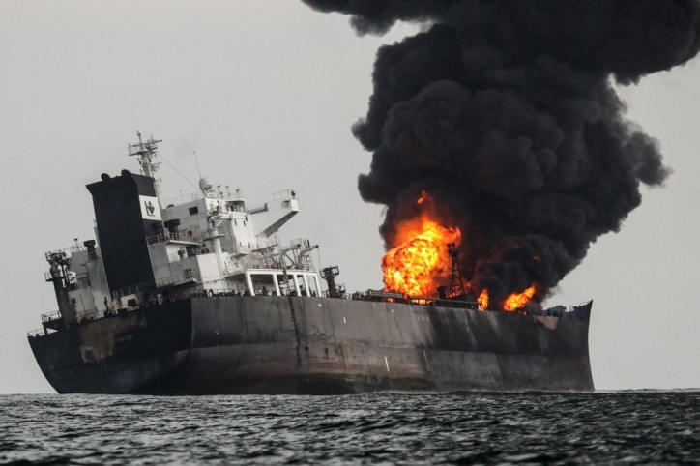

Slide 11
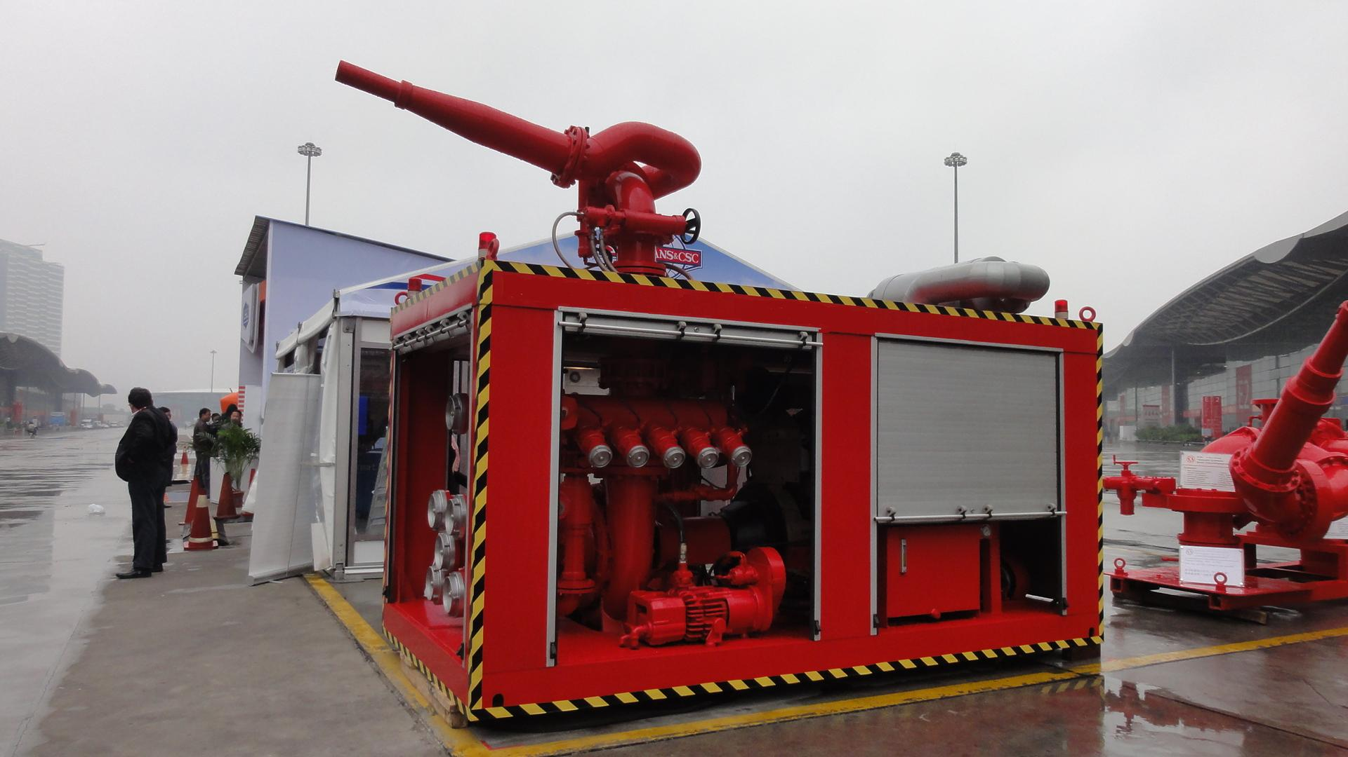
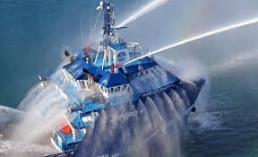
KRAJ!

