Slide 1
GPS
Navigational device

Slide 2
GPS navigation device
A GPS navigation device, GPS receiver, or simply GPS is a device that is capable of receiving information from GPS satellites and then to calculate the device's geographical position. Using suitable software, the device may display the position on a map, and it may offer directions. The Global Positioning System (GPS) is a global navigation satellite system(GNSS) made up of a network of a minimum of 24, but currently 30, satelites placed into orbit by the U.S. Department of Defense

Slide 3
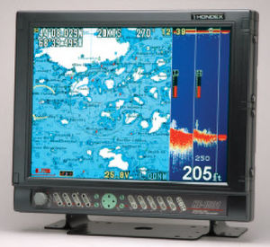
GPS
The GPS was originally developed for use by the United States military, but in the 1980s, the United States government allowed the system to be used for civilian purposes.

Slide 4
GLONASS
The Russian Global Navigation Satellite System (GLONASS) was developed contemporaneously with GPS, but suffered from incomplete coverage of the globe until the mid-2000s. GLONASS can be added to GPS devices to make more satellites available and enabling positions to be fixed more quickly and accurately, to within 2 meters.

Slide 5
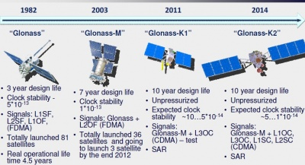
GLONASS Satellites

Slide 6
History of GPS
In 1960, the US Navy put into service its Transit satellite based navigation system to aid in ship navigation. Between 1960 and 1982, as the benefits were been shown, the US military consistently improved and refined its satellite navigation technology and satellite system. In 1973, the US military began to plan for a comprehensive worldwide navigational system which eventually became known as the GPS (global positioning system).

Slide 7
Sensitivity
GPS devices vary in sensitivity, speed, vulnerability to multipath propagation, and other performance parameters. High Sensitivity GPS receivers use large banks of correlators and digital signal processing to search for GPS signals quickly. This results in very fast times to first fix when the signals are at their normal levels, for example outdoors. When GPS signals are weak, for example indoors, the extra processing power can be used to integrate weak signals to the point where they can be used to provide a position.

Slide 8
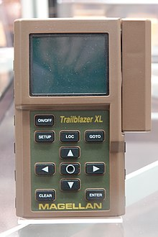
1993 Magellan Trailblazer XL GPS Handheld Receiver

Slide 9
Use on Board Ships
On board, the GPS receiver stores the almanac data for continuous use. It also calculates, exactly how far the satellite is from the ship at any given instant. Three such satellites and the calculations give us an exact 2D fix on board- Latitude and Longitude. If there are four satellites used, one can calculate altitude as well. By keeping a record of the ship’s positions, another simpler calculation determines the ship’s speed, and the course it has ‘made good’ in the time between positions.

Slide 10
THE END
Made by: Josip Radić

