Slide 1
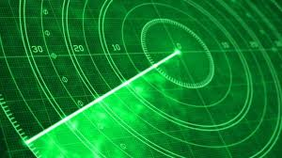
RADAR
Andrija cinotti 2.c.

Slide 2
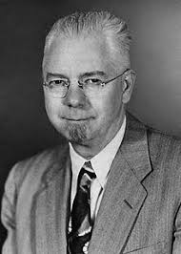
RADAR
The radar was invented by Robert Morris Page 1934.

Slide 3
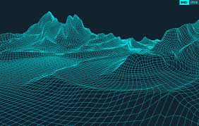
RADAR
Radar-Radio Detection And Ranging - a device for detecting objects on earth, in the sea and in the air using radio waves

Slide 4
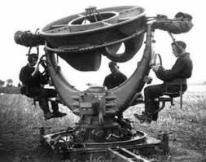
RADAR
The first usable radar had the British at the beginning of the Second World War.
Using the radar they were easier to follow the German airplane crashes, and easier to organize the defense.

Slide 5
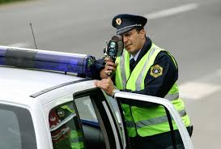
RADAR
Modern radars are used in aviation and navigation to search for goals, but also in astronomy when studying the surface of distant planets.
Nowadays, the police use radar to determine the speed of the vehicle.

Slide 6
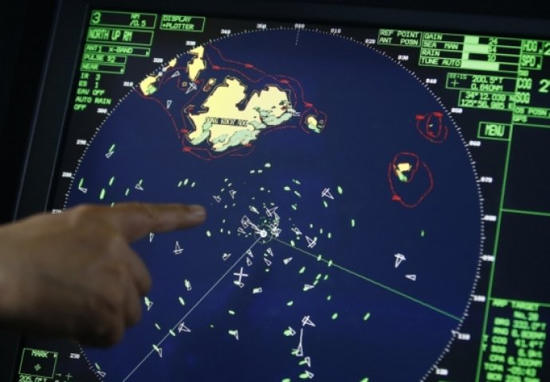
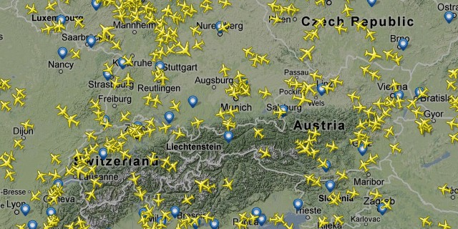
RADAR
Today's modern aviation aviation uses stealth technology that makes the aircraft virtually invisible radar.

Slide 7
RADAR
Antenna emits a short pulse, which is rejected from the target. Based on the time spent returning the beam, the distance from the object is calculated.

Slide 8
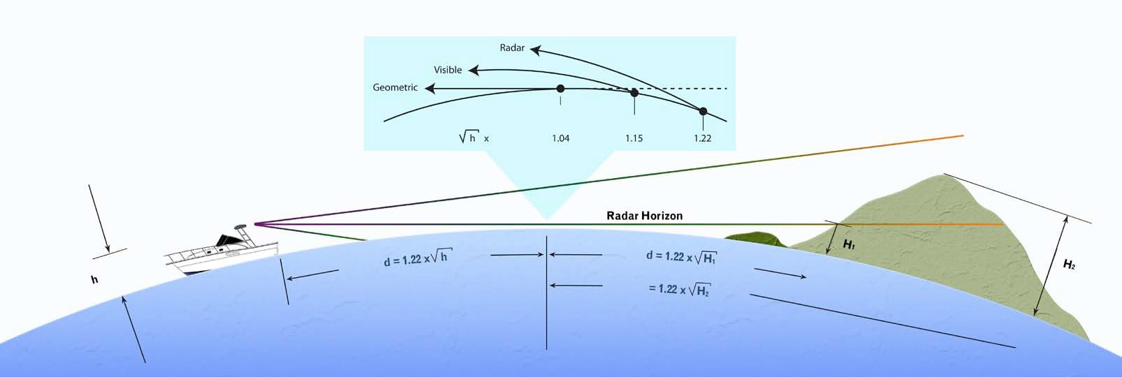
RADAR RANGE
The radar range depends on two factors: the radar horizon and the constructional performance of the device.

Slide 9
RADAR'S HORIZONT
The radar horizon is the distance function, given the curvature of the Earth's surface, as well as atmospheric conditions affecting propagation.
The radar horizon is larger than the optical, because the wavelength of the radar impulse is higher than the wavelength of light, so different densities vary more through the atmospheric layers

Slide 10
FINIŠ
Izradio:Andrija Cinotti

