Slide 1
SEARCH AND RESCUE

Slide 2
Definition
Search and rescue (SAR) is the search for and provision of aid to people who are in distress or imminent danger

Slide 4
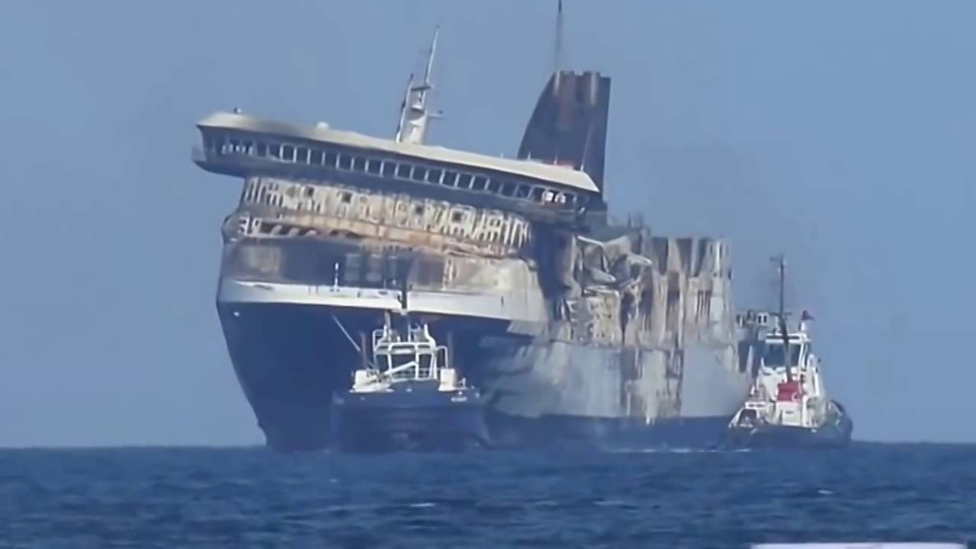
Air–Sea rescue
Is the coordinated search and rescue of the survivors in distress at sea, as well as people who have survived the loss of their sea-going vessel

Slide 5
Air-Sea rescue can involve a wide variety of resources including helicopters, submarines, rescue boats and ships

Slide 6
Helicopters
In the mid 1950s, helicopters began to replace fixed–wing aircraft and supplement the marine craft in the search and rescue role, their ability to hover giving them an ability to recover survivors that fixed wing aircraft did not have

Slide 7
Submarines
Submarine rescue systems emerged nearly simultaneously with undersea fleet and have been progressing with the fleet, while gaining tragic experience of submarine averages and accidents.

Slide 8
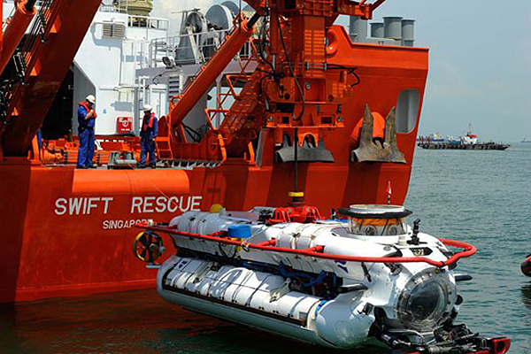
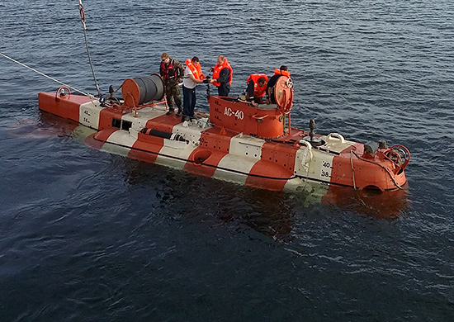
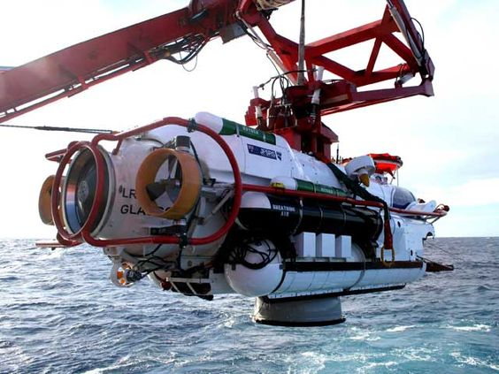

Slide 9
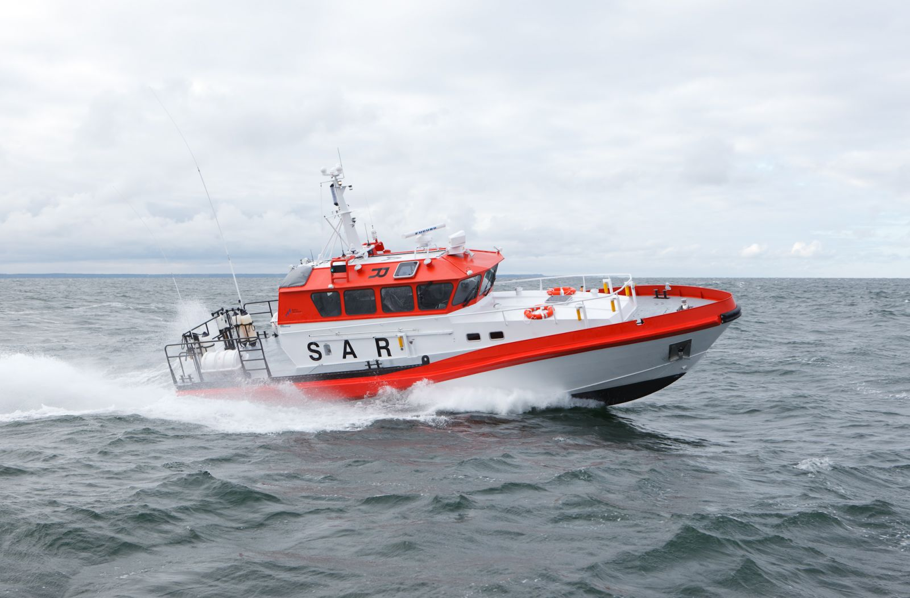
Rescue boats

Slide 10
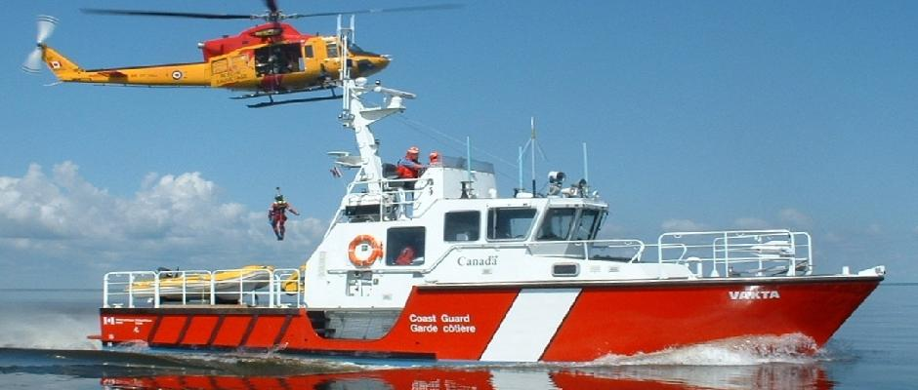
Rescue ships

Slide 11
Rescue plan
A rescue plan will ensure that all the Rescue team efforts are brought to bear in a systematic and coordinated manner, utilizing the most up-to-date intelligence about victims.

Slide 12
The main goal of search and rescue is to save people in distress
Each year there are alot of SAR operations in hope to savea human life

Slide 14
The end
Učenik: Daniel Peršič, 2.c

