Slide 1
SOLAS Safety of life at sea
Tomislav Nanjara 2.c
19.5.2020.
From the comfort of my room

Slide 2
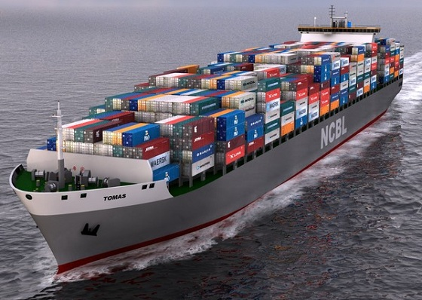
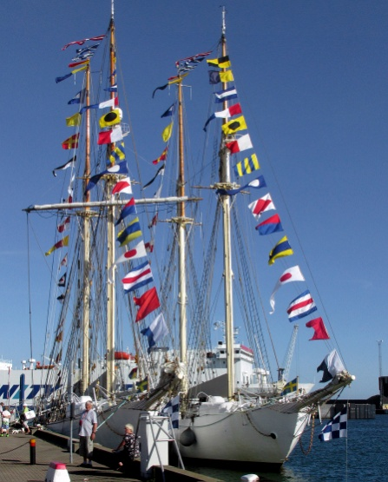
SOLAS rules
The International Convention for the Safety of Life at Sea (SOLAS) is an international maritime treaty which sets minimum safety standards in the construction, equipment and operation of merchant ships.
The convention requires signatory flag states to ensure that ships flagged by them comply with at least these standards.

Slide 3
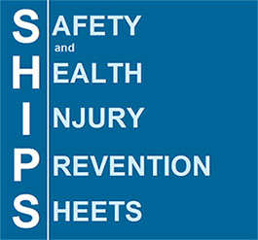
Current SOLAS importance
The current version of SOLAS is the 1974 version, known as SOLAS 1974, which came into force on 25 May 1980. As of November 2018, SOLAS 1974 had 164 contracting states, which flag about 99% of merchant ships around the world in terms of gross tonnage.
SOLAS in its successive forms is generally regarded as the most important of all international treaties concerning the safety of merchant ships.

Slide 4
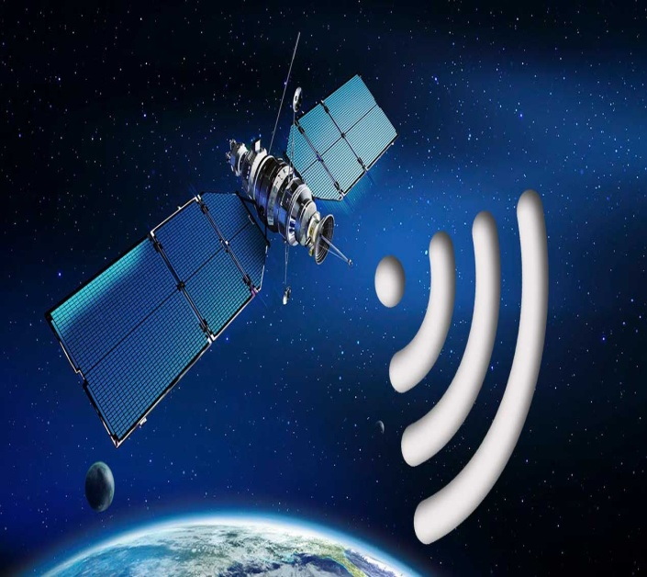
SOLAS public adress system
Under SOLAS all passenger ships must be fitted with a public address system and can now communicate globally via satellites.

Slide 5
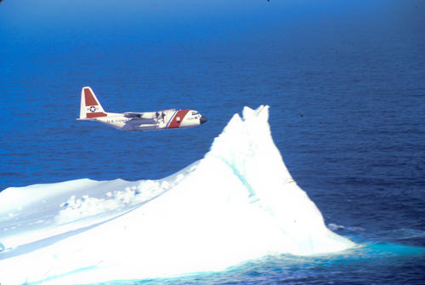
SOLAS ice patrol
In the first SOLAS 1914, after the Titanic disaster, ice patrols in the north Atlantic were set up and continue to be a SOALS requirement.

Slide 6
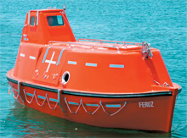
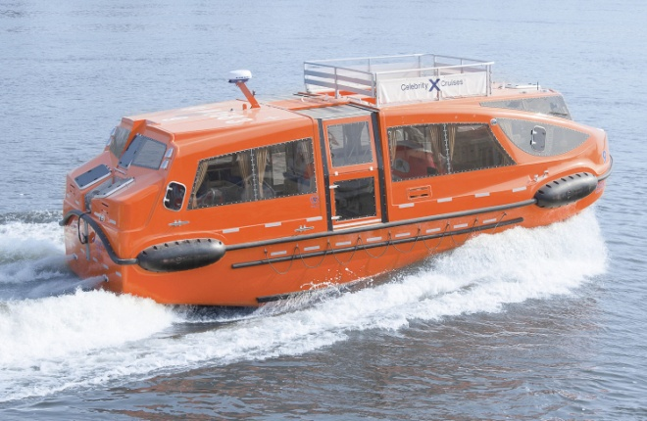
SOLAS life boat design
Under SOLAS lifeboats must be fully or partially enclosed. On passenger ships, partially enclosed lifeboats can be used as they are easier to get into ,but they must have a collapsible roof to fold across

Slide 7
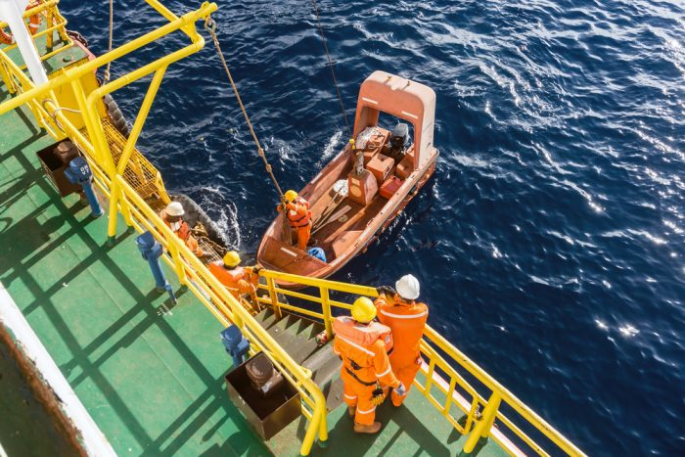
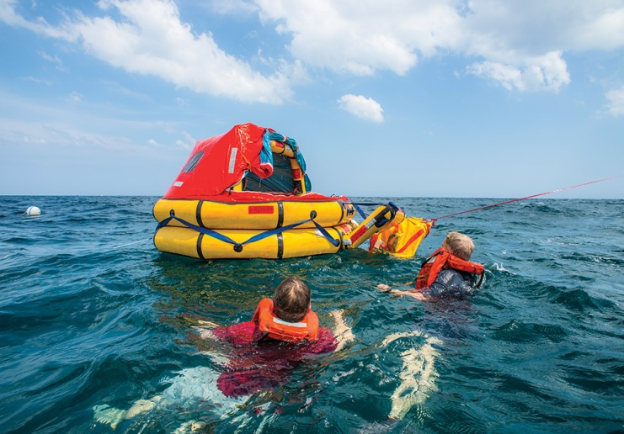
SOLAS lifeboat drills
Under SOLAS chapter III an abandon ship and fire drill must take place weekly on all passenger ships and passenger ships must carry enough lifeboats for all passengers plus liferafts for 25 %

Slide 8
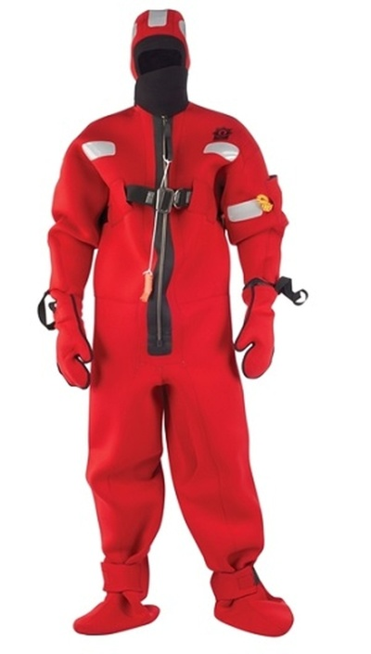
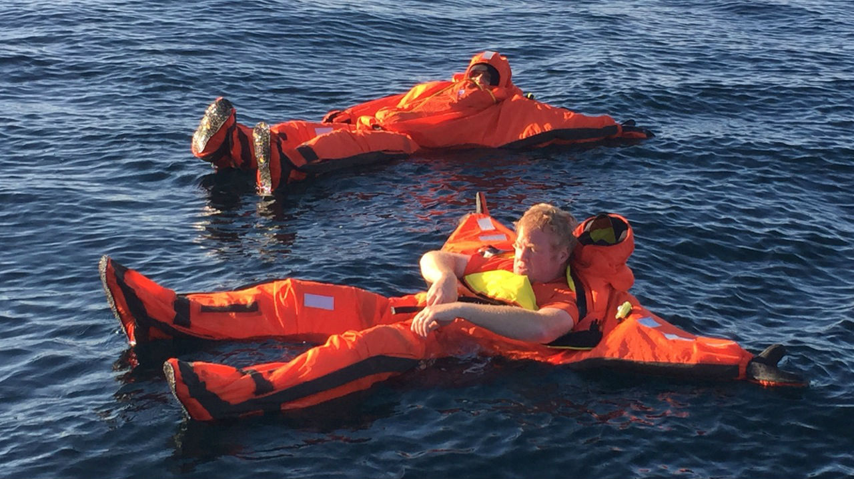
SOLAS immersion suits
Under SOLAS a specific number of immersion suits mumst be carried on both passenger and cargo ships, mainly for the crews of rescue boats

Slide 9
SOLAS explaining videos
https://www.youtube.com/watch?v=HlMuaoLmtn0
https://www.youtube.com/watch?v=jsj0gT4jae4

