Slide 1
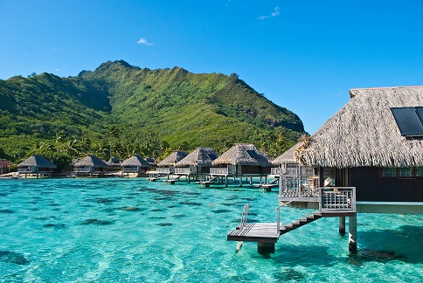
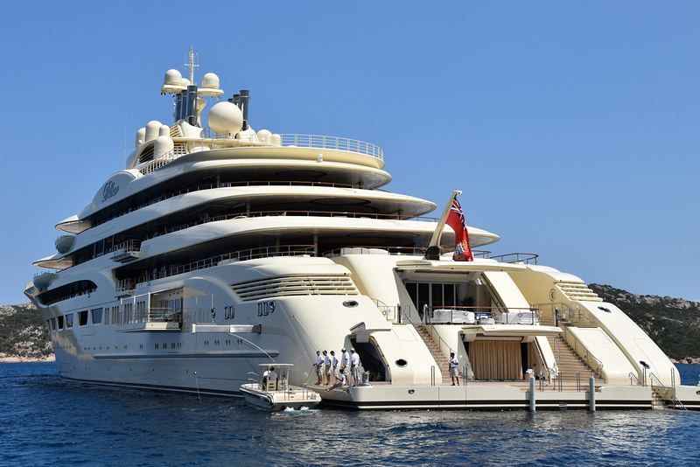
SUPER YACHTS
By šime štokić 2018.

Slide 2
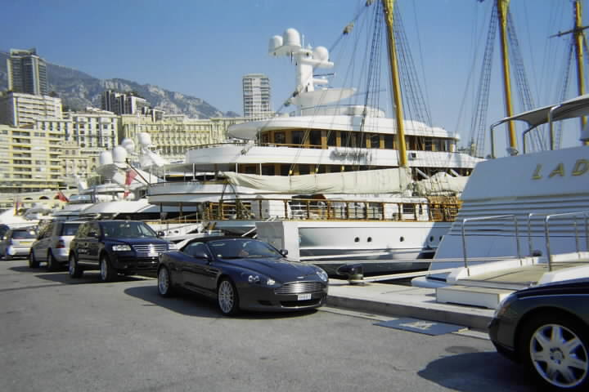
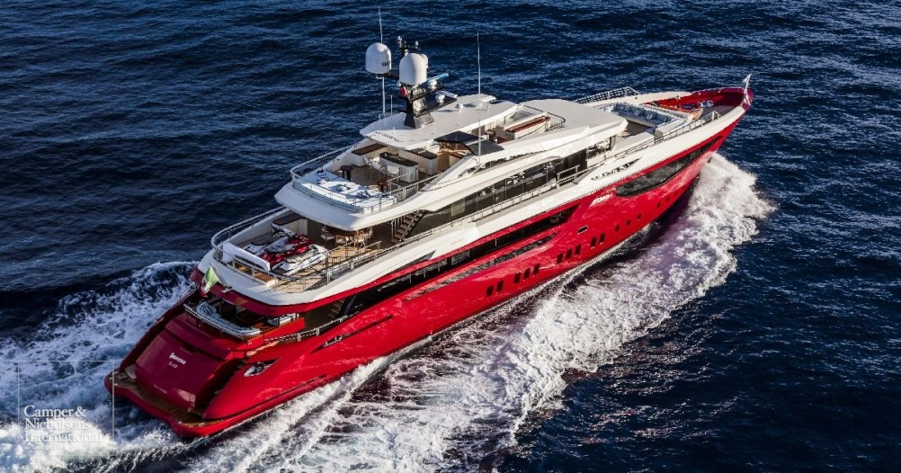
The yacht is smaller or larger vessel for recreation, sport and nautical tourism.

Slide 3
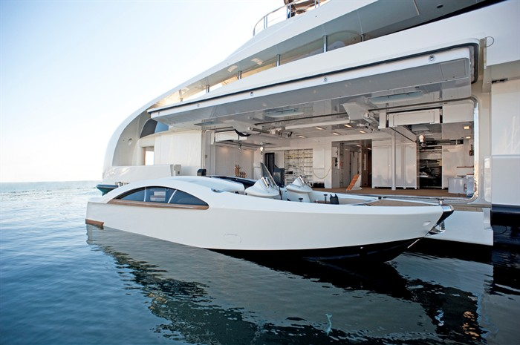
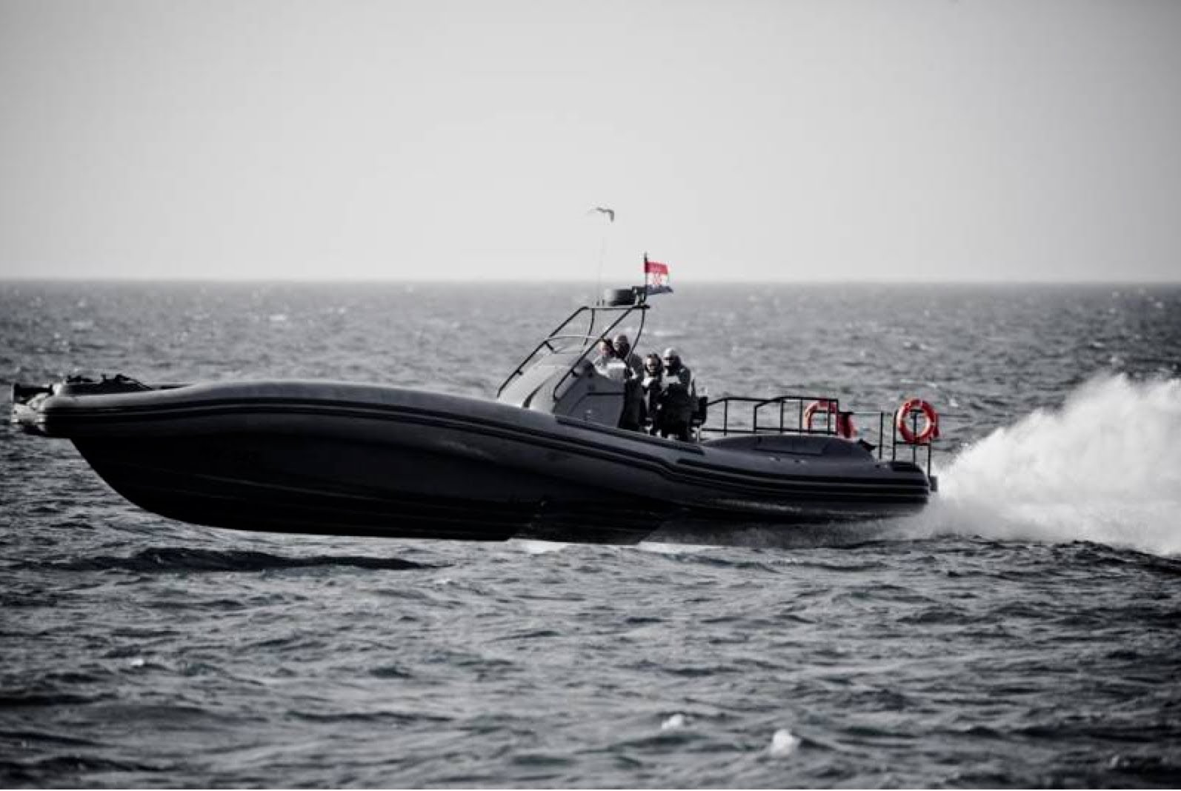
The original definition of the yacht was given by the Dutch navy which served small and fast vessels to prevent piracy in its waters.
OLIMP – HRVATSKA PROIZVODNJA

Slide 4
Most valued sold Croatian yacht is Princess 82 ( around 3 million EUR )

Slide 5
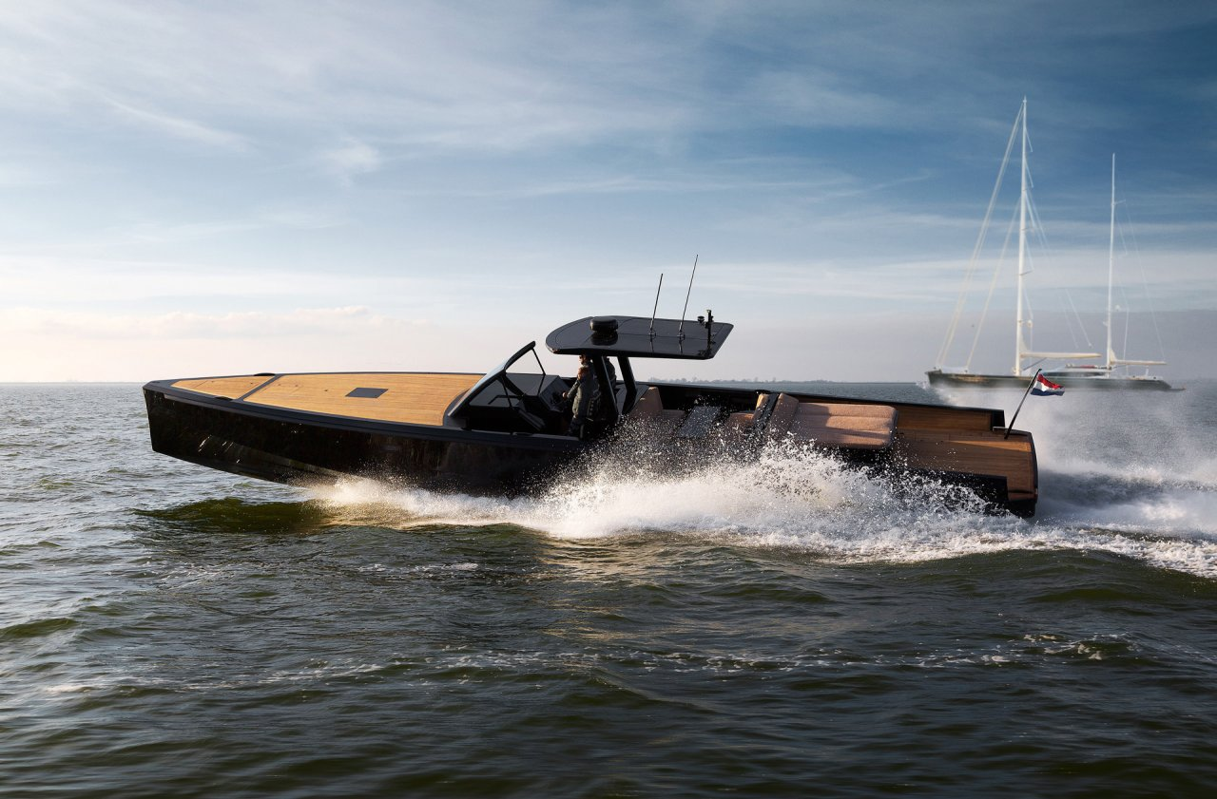
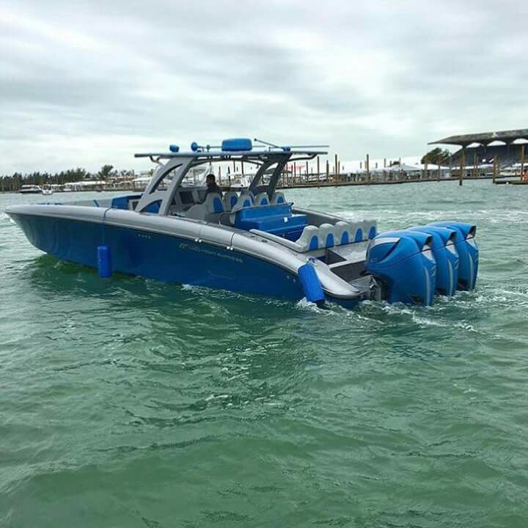
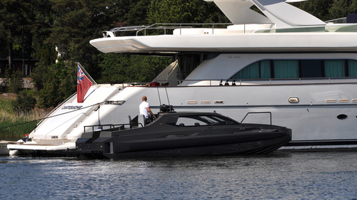
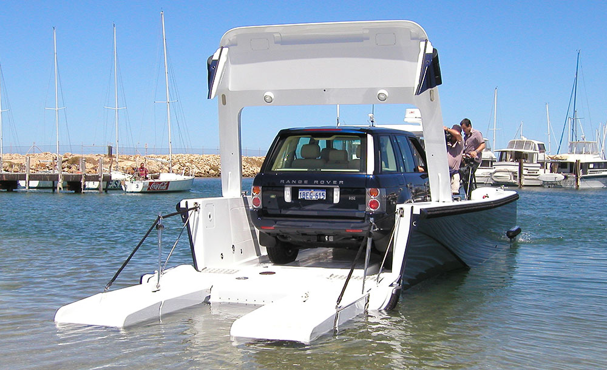
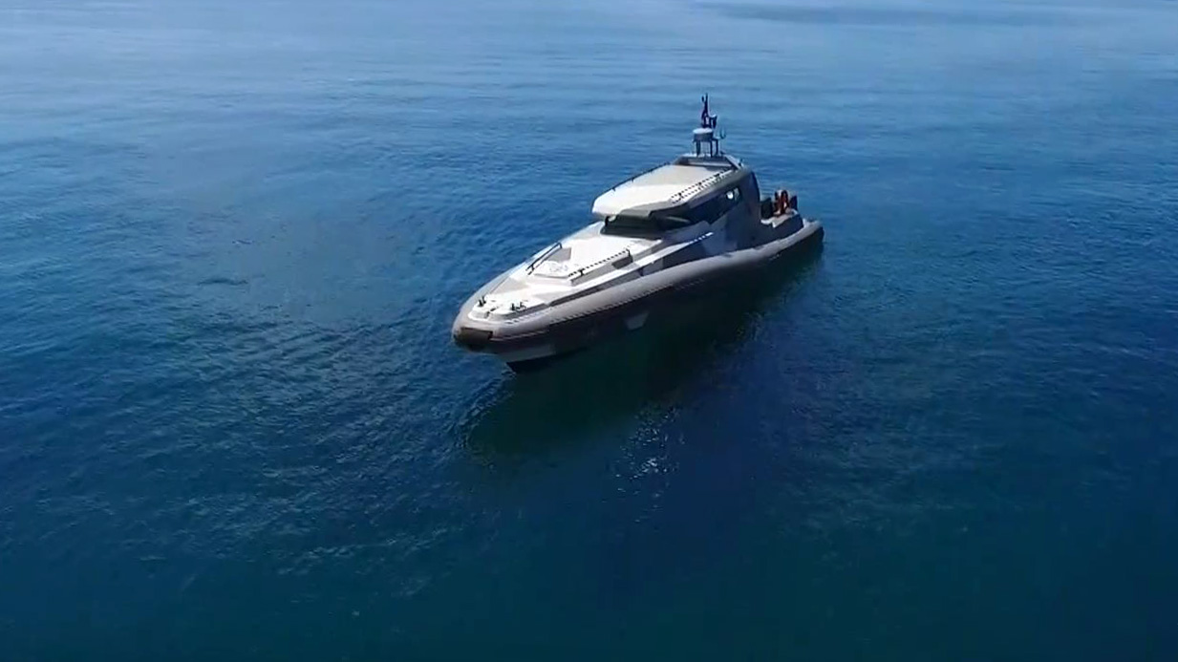
Yachts tenders are comfortable and possess very strong and fast motors (25 – even 60 knots)

Slide 6
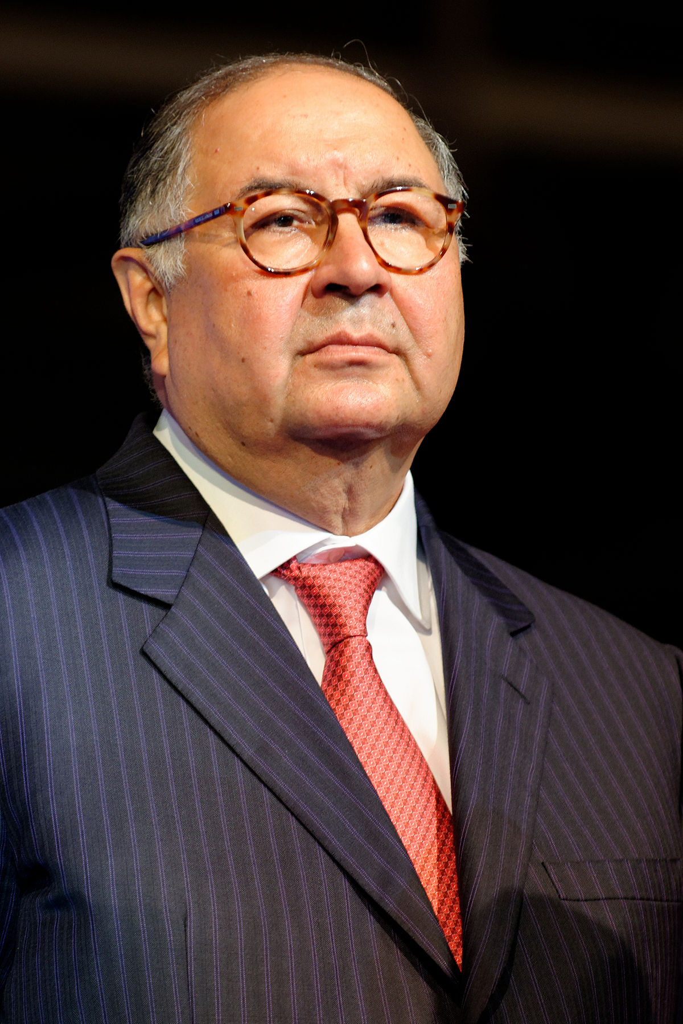
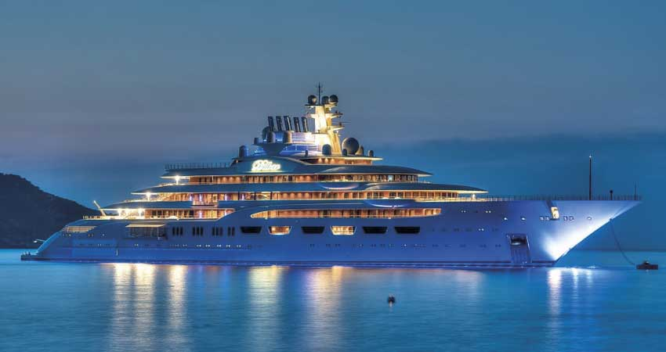
One of the biggest yachts is Dilbar yacht. Yacht Length: 157 m Yacht Value: US$ 600 million Owner: Alisher Usmanov
an Uzbek-born Russian business magnate.
Alisher Usmanov

Slide 7
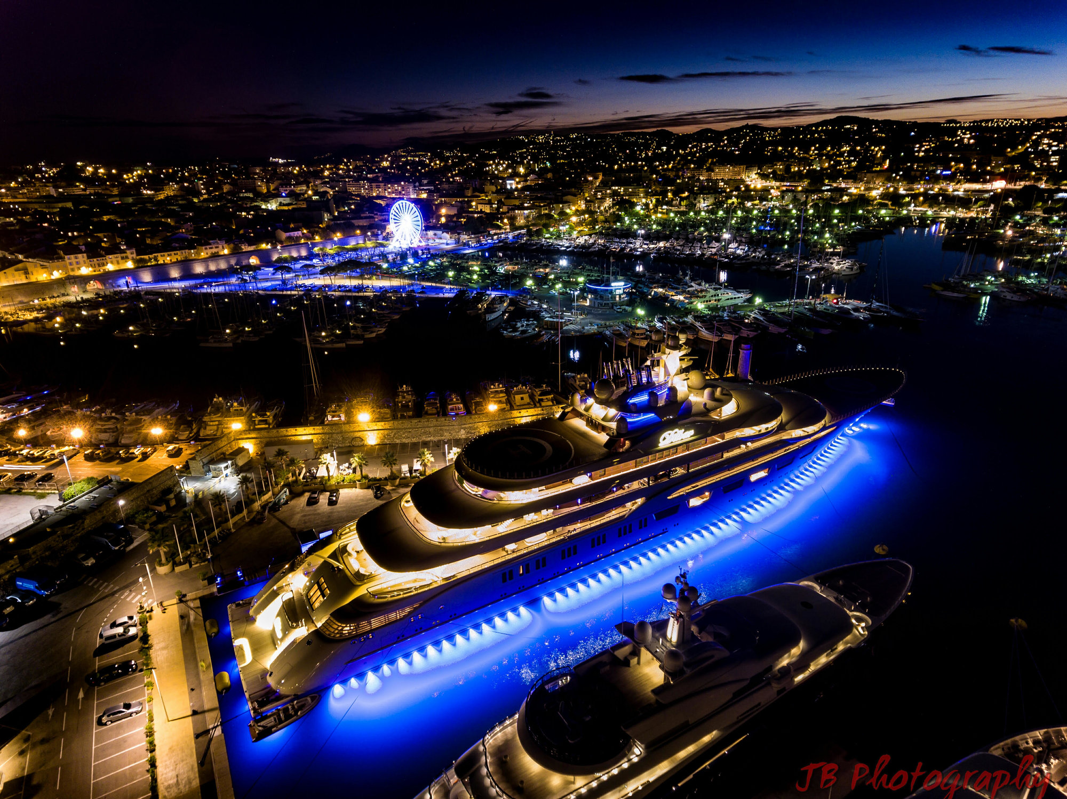
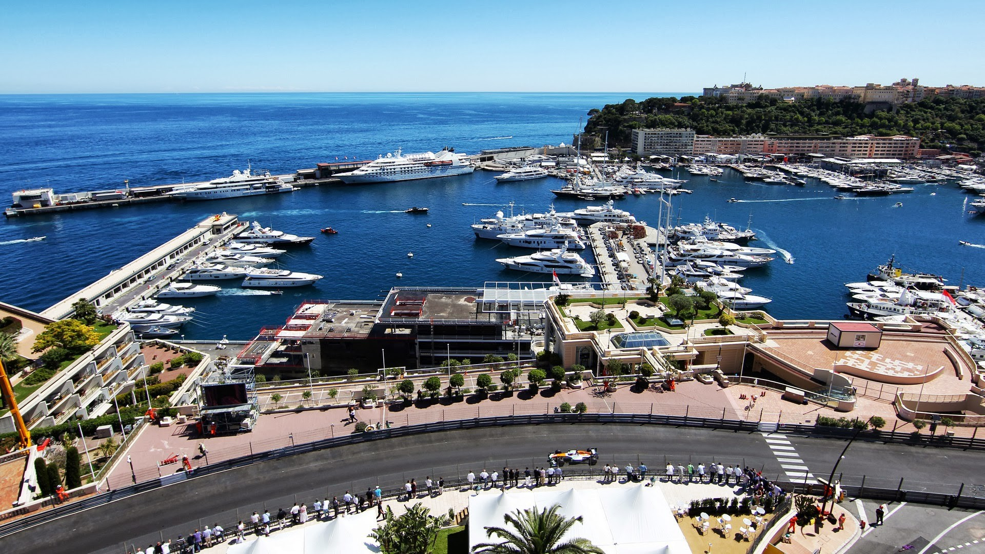
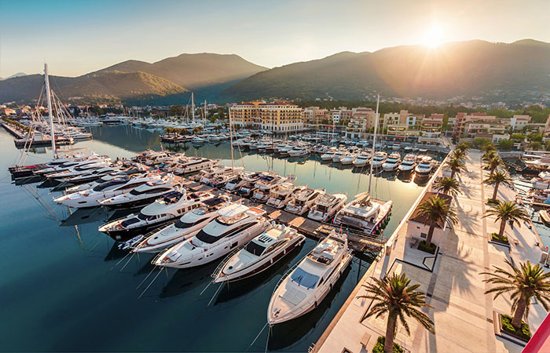
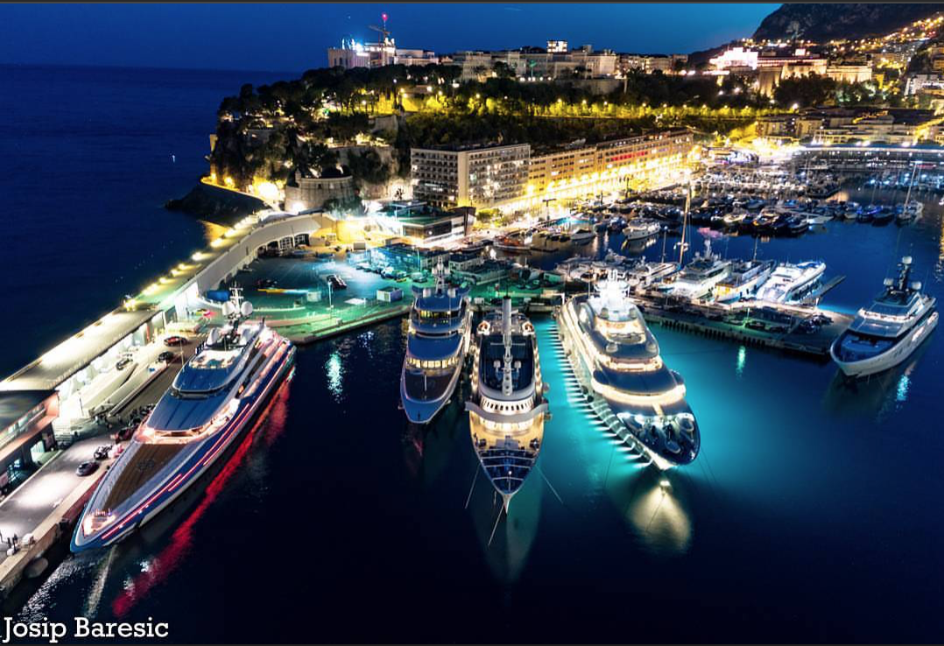
Some of the best yacht marinas in the world are in: Capri, Genova, Sardinia, Ibiza, Abu Dhabi and Monte Carlo.

Slide 8
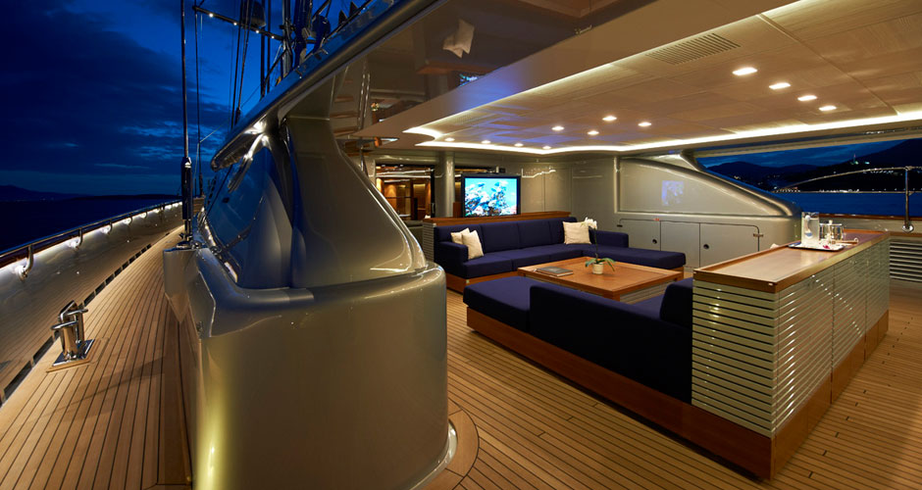
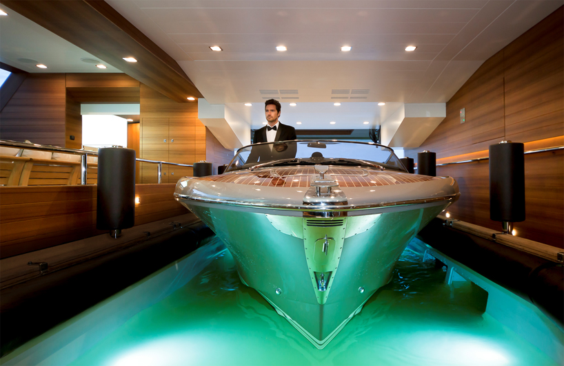
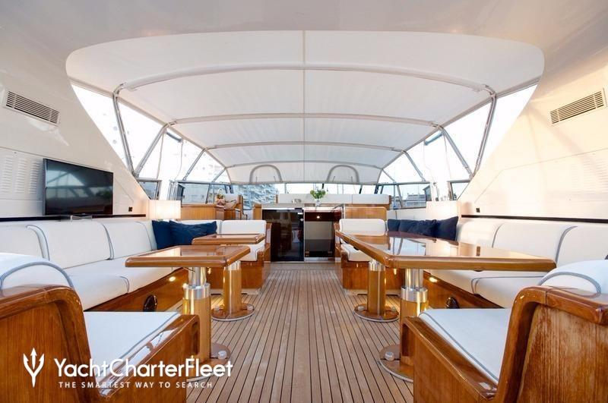
Yachts interior is amazing

Slide 9
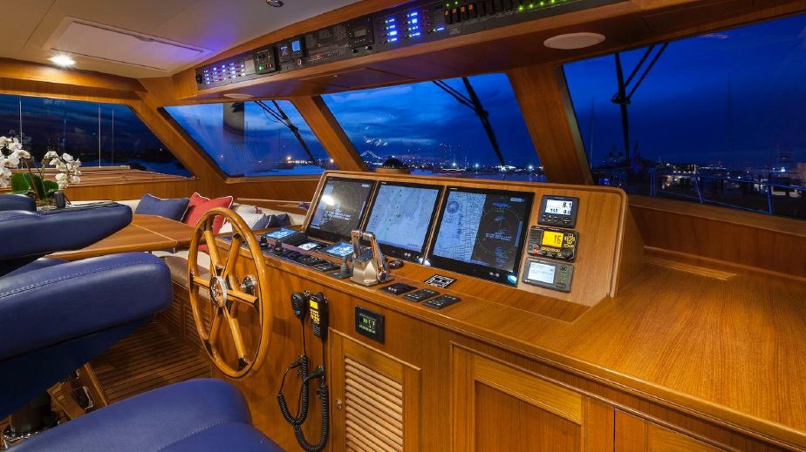
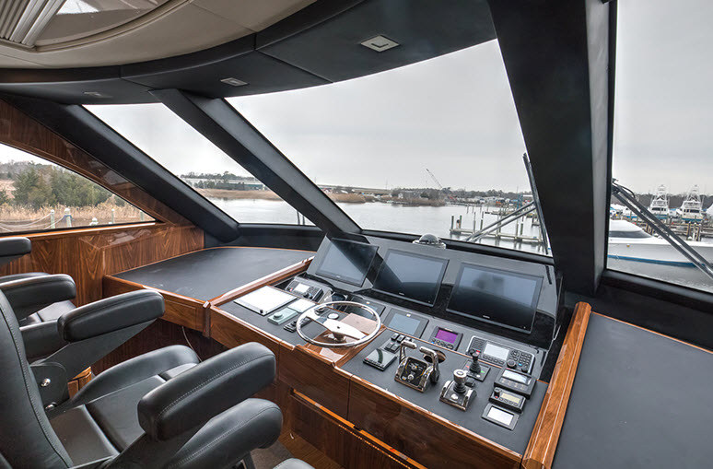
Yachts command rooms are very luxury

Slide 10
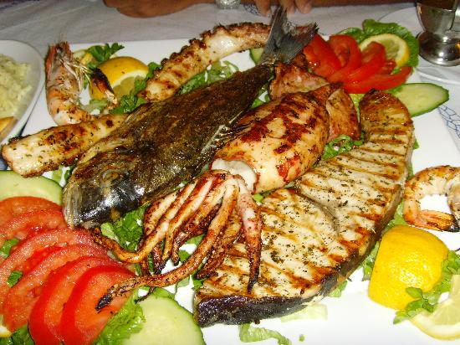
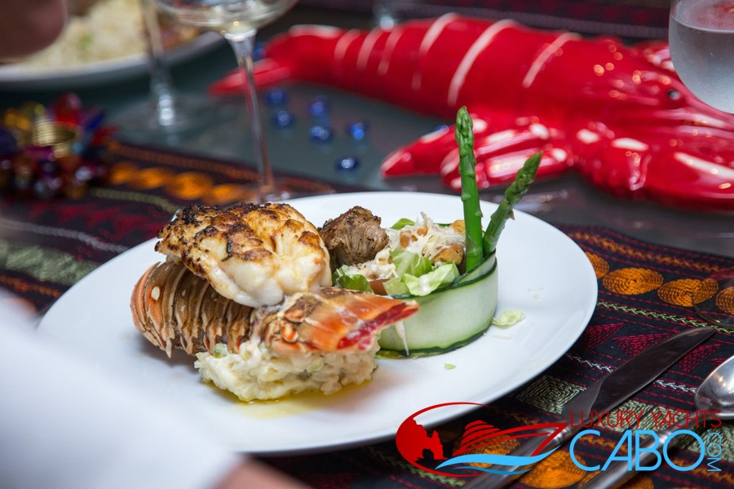
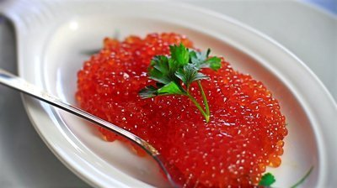
Food is at highest level

Slide 11
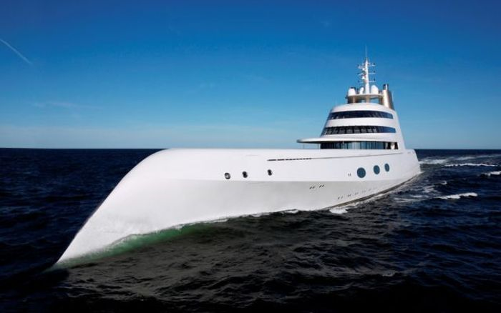
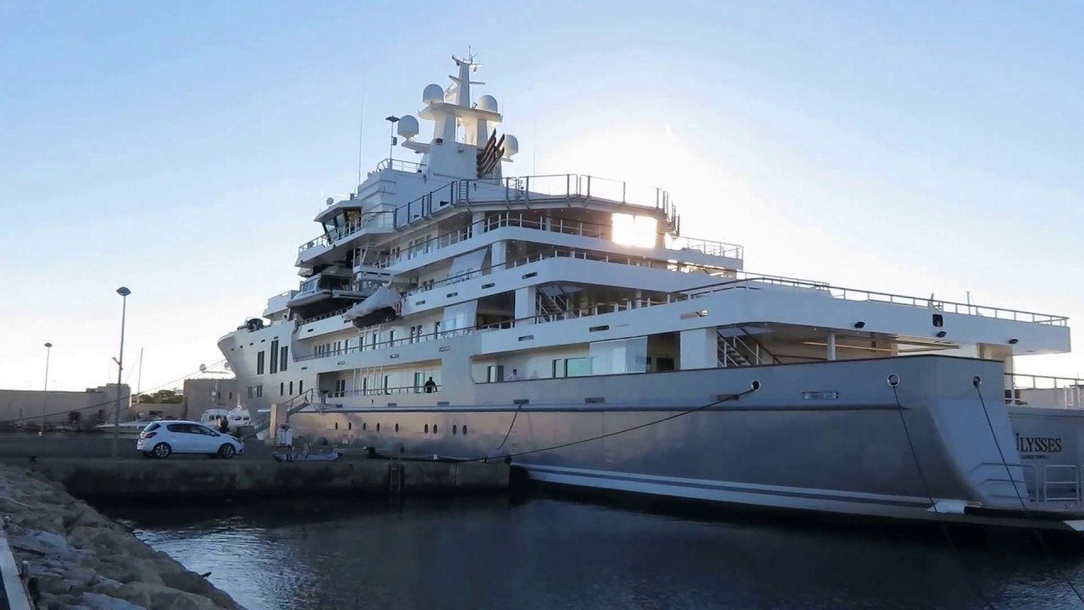
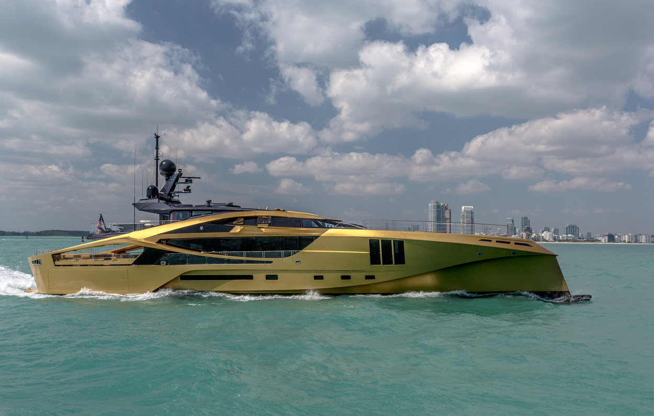

Slide 12
FALA NA POZORNOSTI !!!
Šime Š.
#samodalmacija

