Slide 1
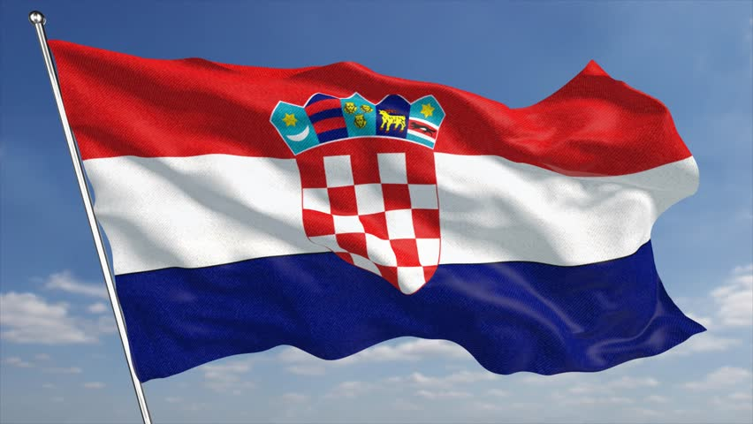
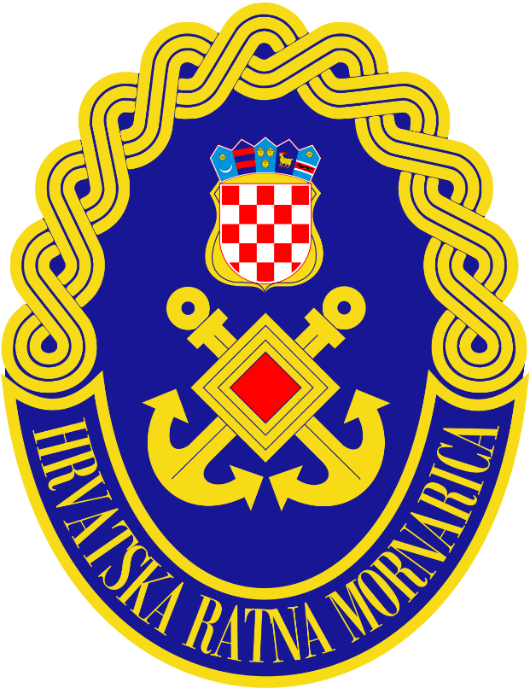
CROATIAN NAVY
Šime Štokić 20.04.2018.

Slide 2
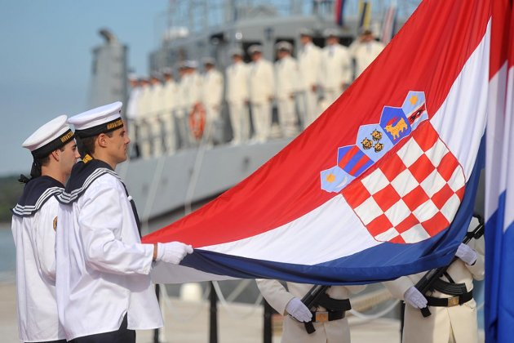
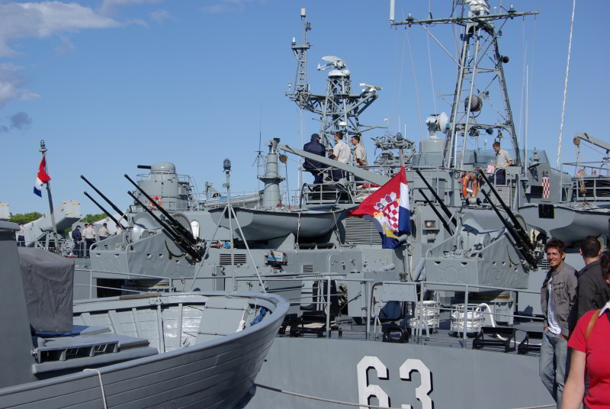
The Croatian Navy (Croatian: Hrvatska ratna mornarica or HRM) is a branch of the Croatian Armed Forces. It was formed in 1991.

Slide 3
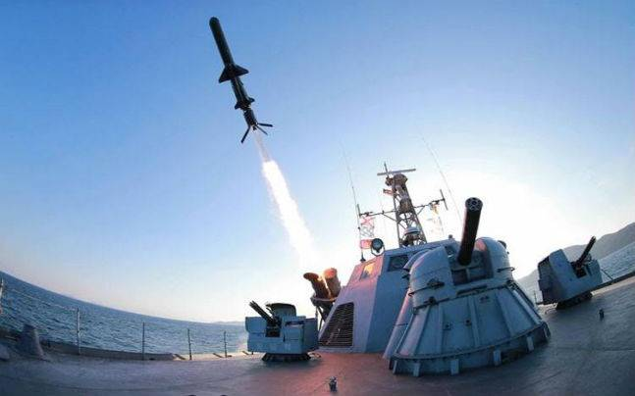
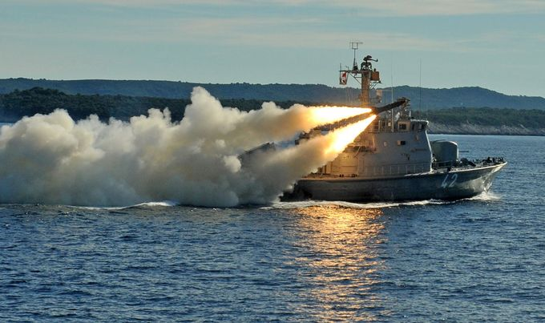
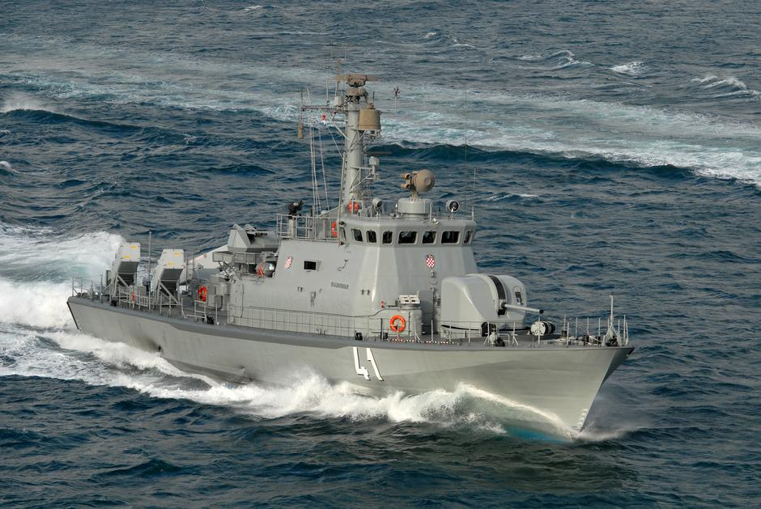
In addition to mobile coastal missile launchers, today it operates 29 vessels

Slide 4
In 2004 Croatia joined the NATO and the Navy was restructured in the process.
The ships reached their full operational capability in June, 2009.

Slide 5
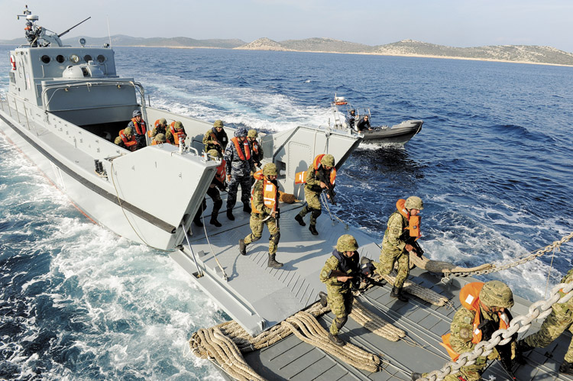
The mission of the Croatian Navy (HRM) is to defend the integrity and sovereignty of the Republic of Croatia, to promote and protect its interest in the Adriatic Sea, islands and coast-lands.

Slide 6
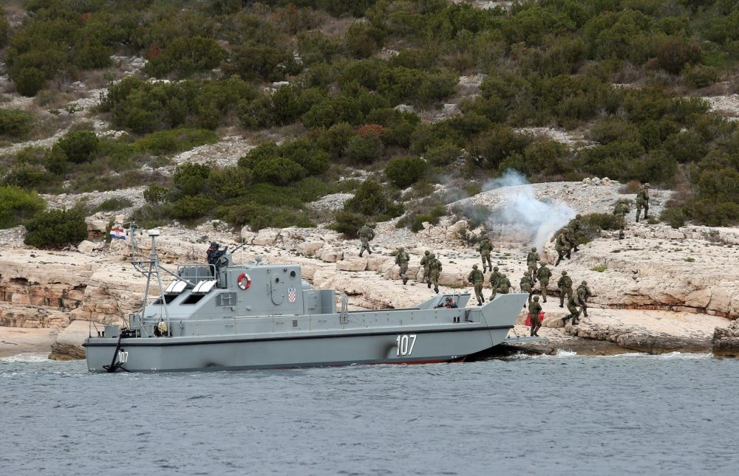
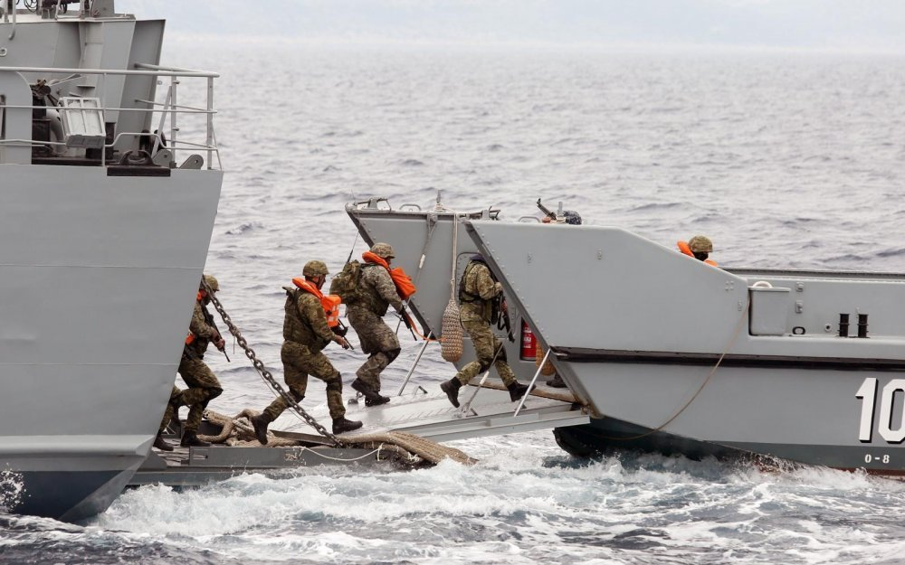
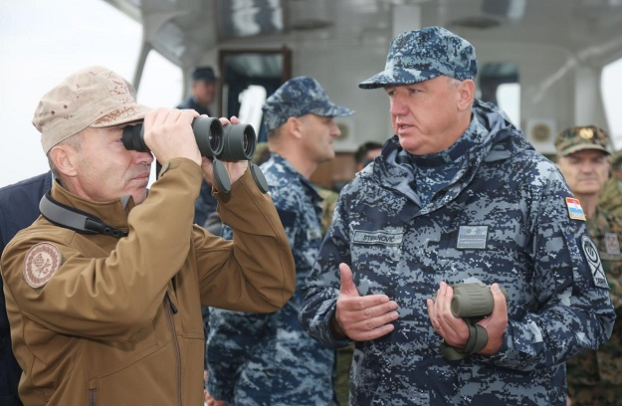
MILITARY EXERCISE - HARPUN 17 -

Slide 7
Ministar Damir Krstičević,poslije vježbe Harpun 17

Slide 8
Croatian Navy operates mostly those vessels that were captured from disintegrating Yugoslav Navy during the Croatian War of Independence in 1991. Most of those have been extensively overhauled or modernized.

Slide 9
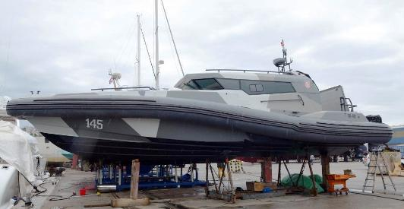
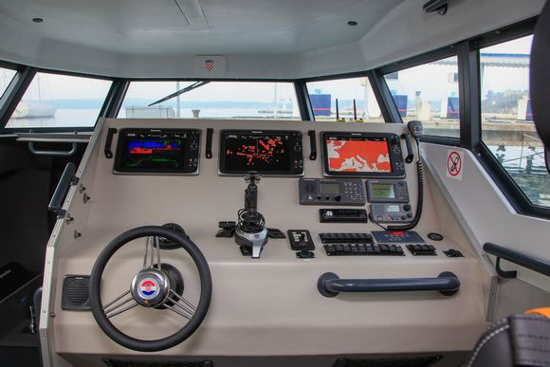
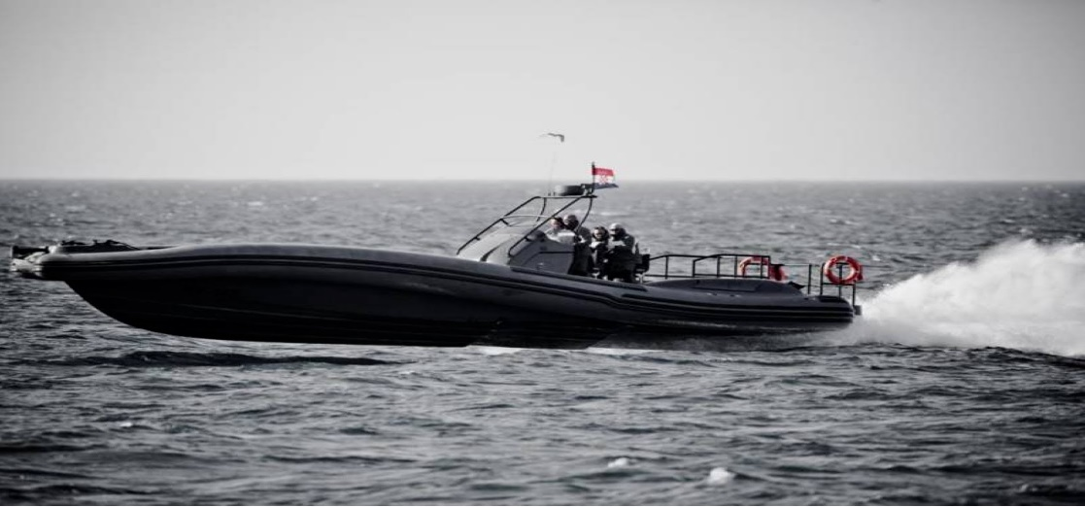
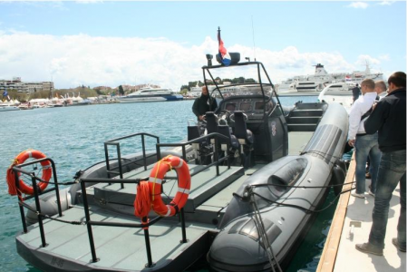
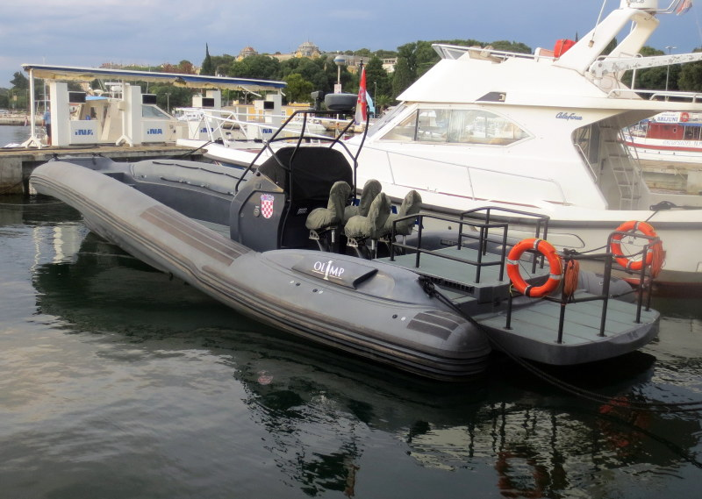
Olimp M-46 is Croatian high speed power boat, it has 2xYanmars 480 hp in-board motors.It can more than 50 knots.

Slide 10
HVALA NA POZORNOSTI
ŠIME Š.
#samodalmacija

